Slide 1




Fault Injection Attacks and Countermeasures
on TinyML Algorithms
Anthony Etim¹*, Srilalith Nampally³*, Aubtin Rasouli³, Dustin Mazza³, Krishna Chilakapati³, Tinghung Chiu³, Ferhat Erata¹,
Leyla Nazhandali³, Wenjie Xiong³ and Jakub Szefer²
*Anthony Etim and Srilaith Nampally contributed equally to this work.
1
2
3
Computer Architecture
and Security Lab (CASLAB)

Slide 2





Tiny Machine Learning (TinyML)
• Runs ML inference directly on resource-constrained devices (microcontrollers, IoT nodes).
Where TinyML lives
• Why: low latency, bandwidth savings, on-device privacy.
Microcontrollers
IoT sensors
• Enabled by quantization, pruning, compact architectures (e.g., int8 with TensorFlow Lite and CMSIS-NN).
• Often deployed in the field — physically accessible to attackers.
Robots / drones
Wearables
©Anthony Etim
https://anthonyedemetim.com/
2

Slide 3
Fault Injection Attacks
• Deliberate transient perturbations of computation or control flow.
Fault Mechanisms in this Work
Mechanism | Effect
Voltage Glitch | VDD drop disrupts MCU computation
EM Pulse | Local transient currents corrupt state
Clock Glitch | Setup-time violations (out of scope)
Laser | Requires chip decapsulation
• Common techniques: voltage glitching, EM pulses, clock glitches, lasers.
• Extensively studied for cryptographic implementations — but TinyML is largely unexplored.
• Goal: find stealthy faults — non-reset, attacker-controllable.
We focus on voltage glitching and EM injection — both practical for field attacks.
©Anthony Etim
https://anthonyedemetim.com/
3

Slide 4


Threat Model
Adversary Capabilities
Out of Scope
• Physical access to the device (IoT nodes, robots, edge sensors).
• Modifying or retraining the model.
• Knows the TinyML model & firmware.
• Adversarial inputs.
• Can inject voltage glitches or EM pulses synchronized with inference.
• Tampering with encrypted input streams.
• Rowhammer (needs code execution on device).
• Controls glitch timing, duration, voltage / pulse amplitude.
• Chip decapsulation / laser injection.
★ Example scenario: an outdoor motion-detection IoT node — injected faults can suppress true alerts or induce false alarms.
©Anthony Etim
https://anthonyedemetim.com/
4

Slide 5
Contributions and Take-aways
1
Systematic fault injection on TinyML
2
Stealthy, attacker-controlled faults
First evaluation across 4 TinyML models (FastGRNN, TinyCNN, Logistic Reg., Wake Word) under voltage glitching and EM injection on two MCU platforms.
Carefully tuned glitches force fixed-label outputs (e.g., TinyCNN → 9.7%) — not just random errors. EM produces persistent state corruption at certain probe positions.
3
Intermediate-value fault analysis
4
RSR-based protections
Recording layer outputs reveals: corruption is common, but only early-ROI bit-flips on wide spans of activations actually flip the final argmax.
Randomized self-reduction + median voting recovers baseline accuracy (< 1% drop) at modest overhead — 1.6× to 34× depending on model structure.
Code & artifacts: github.com/caslab-code/ml-fault-attacks-on-tinyml
©Anthony Etim
https://anthonyedemetim.com/
5

Slide 6




Today's Talk
1
2
3
4
Motivation
Attack Setup
Results
Defense (RSR)
TinyML &
Fault Injection
Voltage glitch
and EM Fault Injection
4 TinyML models
2 platforms
Randomized
Self-Reduction
We show small, well-timed faults can controllably misclassify TinyML models, and propose RSR-based protections that recover accuracy with modest overhead.
©Anthony Etim
https://anthonyedemetim.com/
6

Slide 7
Evaluation
Methodology
©Anthony Etim
https://anthonyedemetim.com/
7

Slide 8
Four Target TinyML Models
FastGRNN
TinyCNN
Logistic Reg.
Wake Word
Domain
Domain
Domain
Domain
Tabular / Sequence
Vision
Binary classify
Audio (always-on)
Architecture
Architecture
Architecture
Architecture
Recurrent + FC
Conv → Pool → FC
FC + Sigmoid
3× FC + Softmax
Total Layers
Total Layers
Total Layers
Total Layers
2 layers
3 layers
1 layer
4 layers
Dataset
Dataset
Dataset
Dataset
MNIST-like 16×16
MNIST 8×8 (int8)
Tabular (11 feat.)
MFCC features (int8)
Attack Region of Interest (ROI)
Attack Region of Interest (ROI)
Attack Region of Interest (ROI)
Attack Region of Interest (ROI)
First recurrent layer
First convolution
Inner product
First dense layer
Spans float & int8 inference, matrix-vector / matrix-matrix / convolution kernels, and different control-flow patterns.
©Anthony Etim
https://anthonyedemetim.com/
8

Slide 9
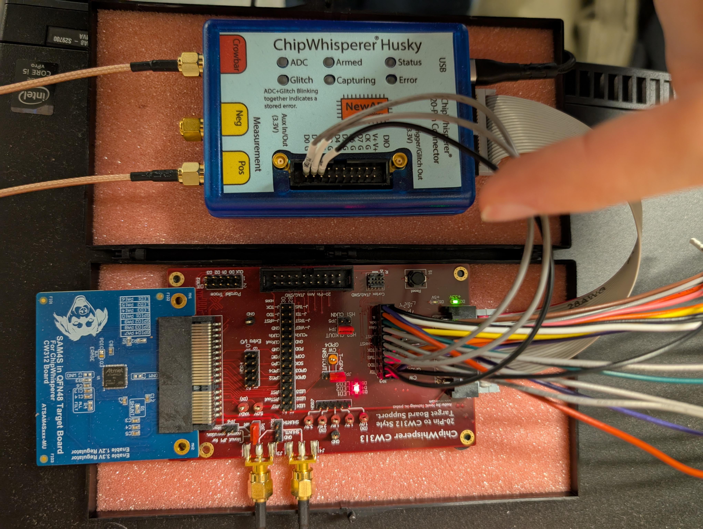
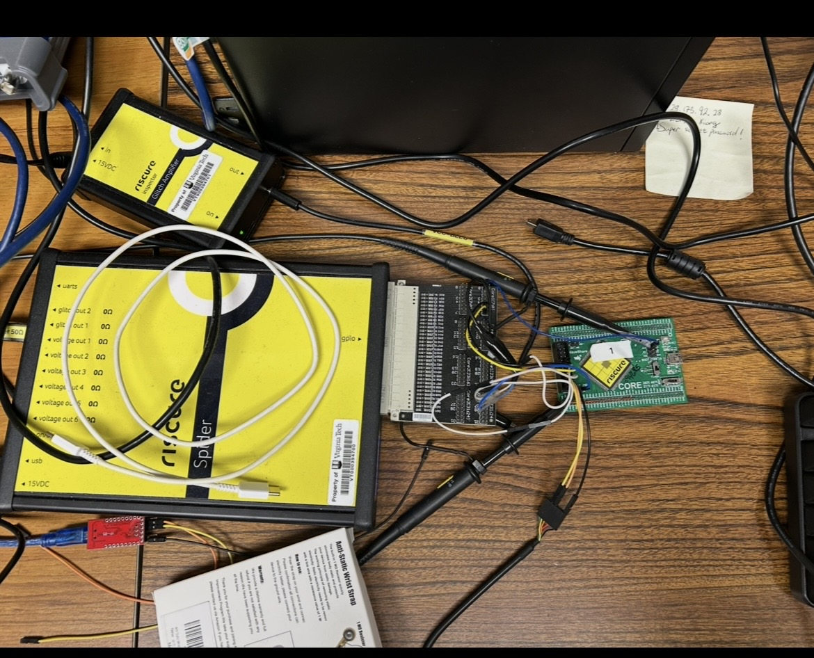
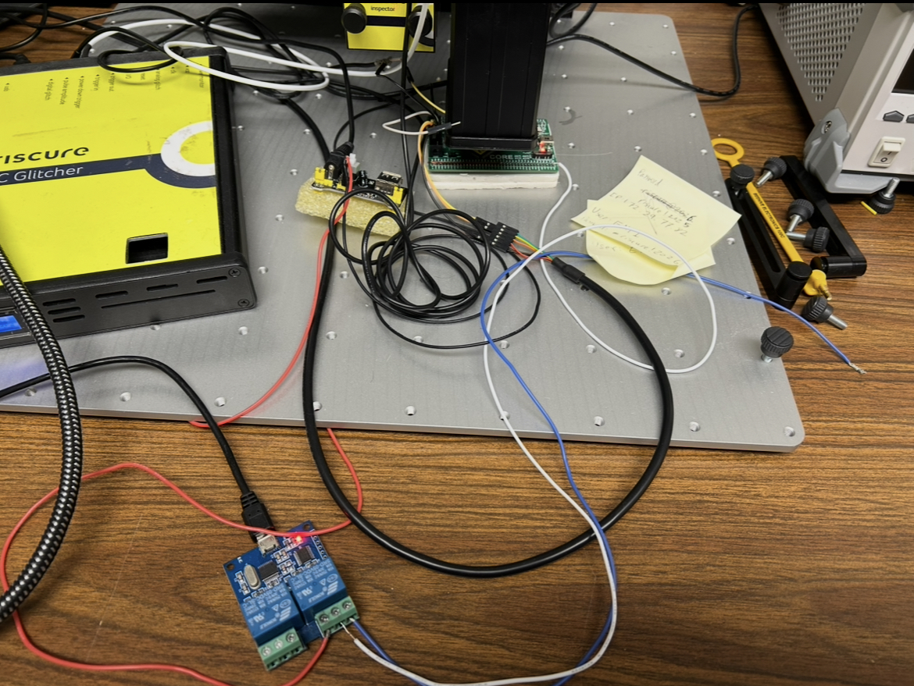
Hardware Setup
Riscure Glitcher
Husky
Riscure Spider
SAMS4S Board
©Anthony Etim
https://anthonyedemetim.com/
9
Notes:
Change to actual pictures of

Slide 10
Hardware Setup
Riscure Glitcher
Husky
Riscure Spider
SAMS4S Board
(a)
(b)
(c)
Pinata Voltage Glitching
Pinata EM Fault Injection
ChipWhisperer-Husky Voltage Glitching
Spider VCC glitcher
STM32F417IG MCU
EM probe and pulse generator
Crowbar glitch on SAM4S
Each trial: Correct / Misprediction / Reset/Hang. We sweep glitch parameters within a Region of Interest (ROI) — typically the first compute-heavy layer.
©Anthony Etim
https://anthonyedemetim.com/
10
Notes:
Change to actual pictures of

Slide 11
Finding Effective (and Stealthy) Faults
Two-stage parameter sweep: maximize mispredictions, minimize resets.
1
Strength × Duration × Position Sweep
2
Injection-Time Sweep
• Pinata voltage: VDD target × glitch duration
• Sweep normalized injection time t ∈ [0, 1] across the ROI.
• Pinata EM: pulse amplitude × probe position
• t = 0 → ROI entry, t = 1 → ROI exit.
• ChipWhisperer: Optuna search over {width, repeat, offset, ext_offset}
• Allows cross-model and cross-platform comparison even when ROI runtimes differ.
• Pick op points that max mispredictions under a reset-rate cap.
• Goal: find the most reliable non-reset faults.
©Anthony Etim
https://anthonyedemetim.com/
11

Slide 12
Experimental
Results
©Anthony Etim
https://anthonyedemetim.com/
12

Slide 13
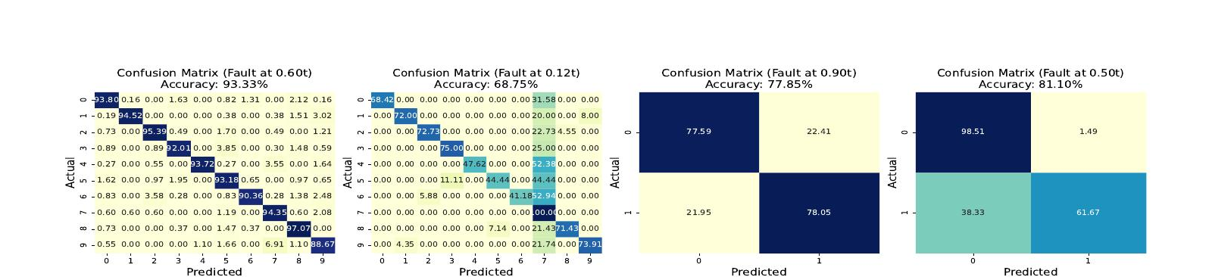
Pinata Voltage Glitching — All Four Models
Confusion matrices at the most-effective injection time per model.
©Anthony Etim
https://anthonyedemetim.com/
13

Slide 14
Pinata Voltage Glitching — All Four Models
Confusion matrices at the most-effective injection time per model.
FastGRNN
TinyCNN
Logistic Reg.
Wake Word
Baseline | t = 0.6t | t = 0t
98.83% | 93.33% | 15.38%
Baseline | t = 0.12t | t = 0t
99.07% | 68.75% | 9.71%
Baseline | t = 0.9t
85.19% | 77.85%
Baseline | t = 0.5t
87.38% | 81.10%
©Anthony Etim
https://anthonyedemetim.com/
14
Notes:
More work needs to be done to find oput why fast tgrnn is robust

Slide 15
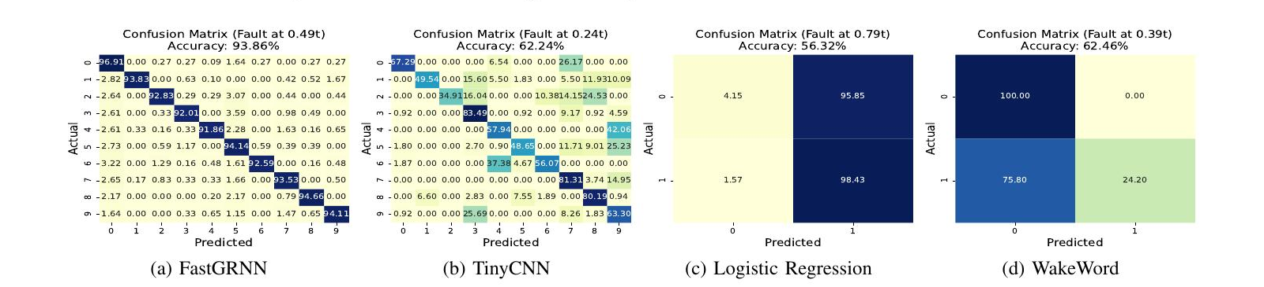
ChipWhisperer-Husky — Cross-Platform Confirmation
Same fault model, different MCU (SAM4S, Cortex-M4) — confirms attack generalizes.
TinyCNN is most vulnerable
Output collapse on binary models
FastGRNN is the most robust
62.24% accuracy with bias toward labels {3, 7, 9}; very early timings push reset rate to 63%.
Logistic Reg. predicts class 1 for nearly all inputs (56.32%); Wake Word collapses to class 0.
93.86% accuracy under attack — modest but consistent degradation only.
©Anthony Etim
https://anthonyedemetim.com/
15

Slide 16
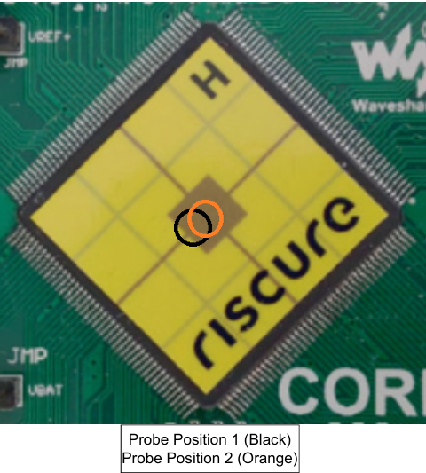
EM Fault Injection — Spatial Sensitivity
Probe Position 1 — TinyCNN
Probe Position 2 (millimeters away)
• Persistent state corruption.
• When a fault hits, all subsequent predictions are corrupted until power-cycle.
• Isolated, prediction-specific faults.
• Compatible with corruption of registers / SRAM.
• At t = 0: accuracy drops to 55.9% (often mispredicts label “7”).
• Intermittent and not repeatable — high impact, low controllability.
• At t = 0.1: recovers to 94.12% — narrow attack window.
Takeaway: EM fault injection is highly spatially sensitive — millimeters change the failure mode entirely.
©Anthony Etim
https://anthonyedemetim.com/
16

Slide 17
Why Do Some Faults Misclassify and Others Don't?
TinyCNN — recording layer outputs under voltage glitching:
1
Intermediate corruption is common
2
Early faults spread widely
3
Late faults (conv layer) get masked
Whenever the device survives the glitch, layer outputs differ from baseline — most of the time.
Early within ROI, a glitch corrupts values that still feed many downstream MAC operations — a single fault contaminates a wide span of bytes, more likely to flip the final argmax.
Late within ROI, most of the layer's output is already committed — corruption is overwhelmed by classifier margin.
©Anthony Etim
https://anthonyedemetim.com/
17
Notes:
Is t here the whole network or the convolution layer? -> Conv layer -> check with Sri?
Ask why fastgrnn is better -> more work needs to be done
Clarify if what t means

Slide 18
Bit-Level Effects in TinyCNN Convolution Output
Two patterns to notice:
• The earliest affected bytes shift right as t grows — faults land on different dynamic instruction windows.
• Broader, denser bit-flip regions co-occur with higher effective error (cf. previous slide).
Why early-ROI matters
Avg. Hamming Weight for Intermediate values vs. injection time t
Conv output (288 B) feeds many downstream MAC ops → early corruption contaminates a wide span of activations and is more likely to flip the final argmax.
©Anthony Etim
https://anthonyedemetim.com/
18

Slide 19
Key Observations — Voltage vs. EM, Across Models
Timing matters
Effective faults concentrated in early-ROI windows. At t ≈ 0, faults often land on init/UART code — but still produce repeatable, attacker-useful failures.
©Anthony Etim
https://anthonyedemetim.com/
19

Slide 20
Key Observations — Voltage vs. EM, Across Models
Timing matters
Model structure matters
Effective faults concentrated in early-ROI windows. At t ≈ 0, faults often land on init/UART code — but still produce repeatable, attacker-useful failures.
TinyCNN is most vulnerable (predictable single-class failures < 20% acc.). FastGRNN is most robust. Logistic Reg. & Wake Word in between (6–8% drops, output collapse risk).
©Anthony Etim
https://anthonyedemetim.com/
20

Slide 21
Key Observations — Voltage vs. EM, Across Models
Timing matters
Model structure matters
Effective faults concentrated in early-ROI windows. At t ≈ 0, faults often land on init/UART code — but still produce repeatable, attacker-useful failures.
TinyCNN is most vulnerable (predictable single-class failures < 20% acc.). FastGRNN is most robust. Logistic Reg. & Wake Word in between (6–8% drops, output collapse risk).
Voltage > EM for control
Voltage glitching: easy to parameterize, reproducible, fewer resets. EM injection: more spatially/mechanically sensitive, but reaches modes voltage cannot (persistent corruption).
©Anthony Etim
https://anthonyedemetim.com/
21

Slide 22
Key Observations — Voltage vs. EM, Across Models
Timing matters
Model structure matters
Effective faults concentrated in early-ROI windows. At t ≈ 0, faults often land on init/UART code — but still produce repeatable, attacker-useful failures.
TinyCNN is most vulnerable (predictable single-class failures < 20% acc.). FastGRNN is most robust. Logistic Reg. & Wake Word in between (6–8% drops, output collapse risk).
Voltage > EM for control
End-to-end ≠ internal
Voltage glitching: easy to parameterize, reproducible, fewer resets. EM injection: more spatially/mechanically sensitive, but reaches modes voltage cannot (persistent corruption).
Confusion matrices alone can't separate masked corruption from real misprediction. Recording intermediate values is essential to understand what's happening.
Synthesis: Carefully tuned faults can controllably force fixed-label outputs — not just random errors. We need protections.
©Anthony Etim
https://anthonyedemetim.com/
22

Slide 23
Lessons Learned — Generalizing to Other Algorithms
t = 0 hits firmware, not the model
Glitches at t ≈ 0 reliably crash accuracy, but they hit UART / firmware setup — not the ML kernel. Report per-region breakdowns or I/O bugs masquerade as ML vulnerability.
©Anthony Etim
https://anthonyedemetim.com/
23

Slide 24
Lessons Learned — Generalizing to Other Algorithms
t = 0 hits firmware, not the model
Use Bayesian search (Optuna)
Glitches at t ≈ 0 reliably crash accuracy, but they hit UART / firmware setup — not the ML kernel. Report per-region breakdowns or I/O bugs masquerade as ML vulnerability.
Brute-force sweeping the 4-D glitch space (width × offset × ext_offset × repeat) takes days per platform. Optuna-style Bayesian search finds productive operating points in hours.
©Anthony Etim
https://anthonyedemetim.com/
24

Slide 25
Lessons Learned — Generalizing to Other Algorithms
t = 0 hits firmware, not the model
Use Bayesian search (Optuna)
Glitches at t ≈ 0 reliably crash accuracy, but they hit UART / firmware setup — not the ML kernel. Report per-region breakdowns or I/O bugs masquerade as ML vulnerability.
Brute-force sweeping the 4-D glitch space (width × offset × ext_offset × repeat) takes days per platform. Optuna-style Bayesian search finds productive operating points in hours.
Inject early in the ROI
Across all four models, effective errors cluster in the first ~10–20% of the ROI — a single early-cycle fault contaminates many downstream MAC ops. Target the first compute-heavy layer.
©Anthony Etim
https://anthonyedemetim.com/
25

Slide 26
Lessons Learned — Generalizing to Other Algorithms
t = 0 hits firmware, not the model
Use Bayesian search (Optuna)
Glitches at t ≈ 0 reliably crash accuracy, but they hit UART / firmware setup — not the ML kernel. Report per-region breakdowns or I/O bugs masquerade as ML vulnerability.
Brute-force sweeping the 4-D glitch space (width × offset × ext_offset × repeat) takes days per platform. Optuna-style Bayesian search finds productive operating points in hours.
Inject early in the ROI
Log intermediate values
Across all four models, effective errors cluster in the first ~10–20% of the ROI — a single early-cycle fault contaminates many downstream MAC ops. Target the first compute-heavy layer.
End-to-end accuracy conflates “fault was masked” with “no fault occurred.” Per-layer logging reveals true intermediate-value error rates and where corruption propagates.
Bottom line: These methodology lessons generalize across algorithms — set up Optuna, log internals, target early-ROI cycles. The rest is model-specific tuning.
©Anthony Etim
https://anthonyedemetim.com/
26

Slide 27
Defense:
Randomized Self-Reduction
©Anthony Etim
https://anthonyedemetim.com/
27

Slide 28
Randomized Self-Reduction (RSR) — The Idea
• Idea: compute f(x) by evaluating f on a few random inputs and recombining the results.
RSR Pipeline
Input x
• Toy example (linear function f(x) = c·x):
Randomize
x → x+r, r
• pick random r → f(x) = c·(x-r) + c·r
= f(x − r) + f(r).
Evaluate f
on each variant
• Repeat T times with fresh randomness, then take the median — outliers from faults are filtered out.
Recombine
(median vote)
Output f(x)
©Anthony Etim
https://anthonyedemetim.com/
28
Notes:
so a single evaluation on x is replaced by two evaluations on
random points x − r and r and one addition

Slide 29
Protecting Logistic Regression
Two RSR identities
Self-Correcting Logistic Regression
1. Inner product is linear:
wᵀ(x + r) − wᵀr = wᵀx
Repeat N times (N = ⌈log(1/β)⌉):
sample r ~ Uniform(−1, 1)ⁿ
2. Sigmoid has a multiplicative RSR:
σ(a − b) = σ(a)·(1 − σ(b))
÷ [−2σ(a)σ(b) + σ(a) + σ(b)]
p₁ ← σ(wᵀ(x+r) + b)
p₂ ← σ(wᵀr)
yᵢ ← rsrprop(p₁, p₂)
Recover σ(wᵀx + b) from σ(wᵀ(x+r)+b) and σ(wᵀr) — without ever computing the unprotected inner product.
Return median(y₁ … y_N) as ŷ
Same fixed-point representation — drop-in replacement.
©Anthony Etim
https://anthonyedemetim.com/
29

Slide 30
Matrix-Vector Multiply & Convolution
Both reduce to the same protected primitive — bilinearity does the work.
Matrix-Vector Multiplication
Convolution (via im2col)
Decompose both operands:
v = v_rand + v_pert
W = W_rand + W_pert
Bilinearity → 4 partial products:
vW = v_r·W_r + v_p·W_r
+ v_r·W_p + v_p·W_p
Repeat T = 5 times with fresh randomness; elementwise median filters out faulted entries.
Convolution = sequence of vector-matrix products:
Each spatial patch → flattened vector A
Each output channel → weight column B
Apply same RSR decomposition:
A = A_r + A_p, B = B_r + B_p
Reuses the protected vec-mat primitive — no architecture changes.
©Anthony Etim
https://anthonyedemetim.com/
30

Slide 31
Protection: Effectiveness & Overhead
Accuracy: Baseline / Faulted / Protected
Runtime Overhead
Model | Baseline | Faulted | Protected
FastGRNN | 98.83% | 15.4 – 98.8% | 98.75%
Logistic Reg. | 85.19% | 77.9 – 85.2% | 85.24%
Wake Word | 87.38% | 81.1 – 91.2% | 87.36%
TinyCNN | 99.07% | 9.7 – 98.4% | 98.80%
Protected accuracy < 1% drop from baseline across all 4 models.
FastGRNN's overhead reflects RSR cost compounding across recurrent timesteps.
Bottom line: RSR fully recovers accuracy under attack with overhead within typical embedded budgets for security-sensitive deployments.
©Anthony Etim
https://anthonyedemetim.com/
31
Notes:
Backup slide for slide fastgrnn architecture ->

Slide 32
Limitations & Future Directions
RSR protects transient computation faults
It does not guarantee recovery from persistent architectural state corruption (Probe Position 2 EM regime — corrupted SRAM/registers across inferences).
Persistent faults need complementary defenses
Canaries, checksums on model state, and periodic state-integrity checks remain necessary for full coverage.
Multiple MCU evaluation
Two MCU families covered (STM32 and SAM4S). Broader silicon (RISC-V, vendor-specific accelerators) and more complex TinyML models remain to be evaluated.
Beyond inference
On-device fine-tuning and federated TinyML create new attack surfaces our threat model does not yet address.
©Anthony Etim
https://anthonyedemetim.com/
32

Slide 33
Summary
1
Systematic fault injection on TinyML
2
First evaluation across 4 TinyML models (FastGRNN, TinyCNN, Logistic Reg., Wake Word) under voltage glitching and EM injection on two MCU platforms.
3
4
©Anthony Etim
https://anthonyedemetim.com/
33

Slide 34
Summary
1
Systematic fault injection on TinyML
2
Stealthy, attacker-controlled faults
First evaluation across 4 TinyML models (FastGRNN, TinyCNN, Logistic Reg., Wake Word) under voltage glitching and EM injection on two MCU platforms.
Carefully tuned glitches force fixed-label outputs (e.g., TinyCNN → 9.7%) — not just random errors. EM produces persistent state corruption at certain probe positions.
3
4
©Anthony Etim
https://anthonyedemetim.com/
34

Slide 35
Summary
1
Systematic fault injection on TinyML
2
Stealthy, attacker-controlled faults
First evaluation across 4 TinyML models (FastGRNN, TinyCNN, Logistic Reg., Wake Word) under voltage glitching and EM injection on two MCU platforms.
Carefully tuned glitches force fixed-label outputs (e.g., TinyCNN → 9.7%) — not just random errors. EM produces persistent state corruption at certain probe positions.
3
Intermediate-value fault analysis
4
Recording layer outputs reveals: corruption is common, but only early-ROI bit-flips on wide spans of activations actually flip the final argmax.
©Anthony Etim
https://anthonyedemetim.com/
35

Slide 36
Summary
1
Systematic fault injection on TinyML
2
Stealthy, attacker-controlled faults
First evaluation across 4 TinyML models (FastGRNN, TinyCNN, Logistic Reg., Wake Word) under voltage glitching and EM injection on two MCU platforms.
Carefully tuned glitches force fixed-label outputs (e.g., TinyCNN → 9.7%) — not just random errors. EM produces persistent state corruption at certain probe positions.
3
Intermediate-value fault analysis
4
RSR-based protections
Recording layer outputs reveals: corruption is common, but only early-ROI bit-flips on wide spans of activations actually flip the final argmax.
Randomized self-reduction + median voting recovers baseline accuracy (< 1% drop) at modest overhead — 1.6× to 34× depending on model structure.
Code & artifacts: github.com/caslab-code/ml-fault-attacks-on-tinyml
©Anthony Etim
https://anthonyedemetim.com/
36

Slide 37
Fault Injection Attacks and Countermeasures
on TinyML Algorithms
Thank you!
anthony.etim@yale.edu, nsrilalith@vt.edu, aubtinr@vt.edu
Questions?
Code: github.com/caslab-code/ml-fault-attacks-on-tinyml
Supported by NSF (CCF-2245344, CCF-2153748, CNS-2442993), CCI, AFOSR (FA9550-22-1-0548).
©Anthony Etim
https://anthonyedemetim.com/
37

Slide 38
Backup: Why FastGRNN Has the Highest Protection Overhead
Only the matVecs are protected — but they live inside the recurrent loop, so RSR cost is paid every timestep.
Protected FastGRNN Cell — Pseudocode
Why the Cost Compounds
for t = 0 to T_steps−1: ← recurrent loop, T_steps = 16
normalize_input(x[t])
protectedmatVec(W1, x_norm) ← T=5 RSR variants + median
protectedmatVec(W2, ·) ← T=5 RSR variants + median
protectedmatVec(U1, h) ← T=5 RSR variants + median
protectedmatVec(U2, ·) ← T=5 RSR variants + median
for i = 0 to hiddenDims−1:
gate = sigmoid(z[i] + Bg[i]) (unprotected)
update = tanh (z[i] + Bh[i]) (unprotected)
h[i] = gate·h[i] + (ζ(1−gate)+ν)·update
Red = the only RSR-protected operations. The activations and hidden-state update are left untouched.
matVec dominates the inference cost
Almost all FLOPs in the cell live in the four low-rank multiplies (W1, W2, U1, U2) — protecting them is enough to dominate the runtime.
Each protectedmatVec ≈ 4·T_rsr → ~20×
One matVec → 4 partial products × T=5 RSR repeats + elementwise median (T_steps cancels in the ratio).
Tight recurrent loop hurts amortization
4 small low-rank matVecs × 16 timesteps = 64 protected calls per inference. Per-call costs (RNG, median scan, buffer setup) don't amortize and push the ratio past the 20× per-call multiplier.
Net effect
~20× per call, plus per-call setup amplification → 34× measured. One-shot models: matVec is a smaller share of total inference, so net overhead is just 1.6–9×.
Bottom line: each protectedmatVec is ~20× a regular matVec, and FastGRNN spends nearly all of inference inside 4 × 16 = 64 such calls — small low-rank matVecs amplify per-call overhead to ~34×.
©Anthony Etim
https://anthonyedemetim.com/
38

