Slide 1
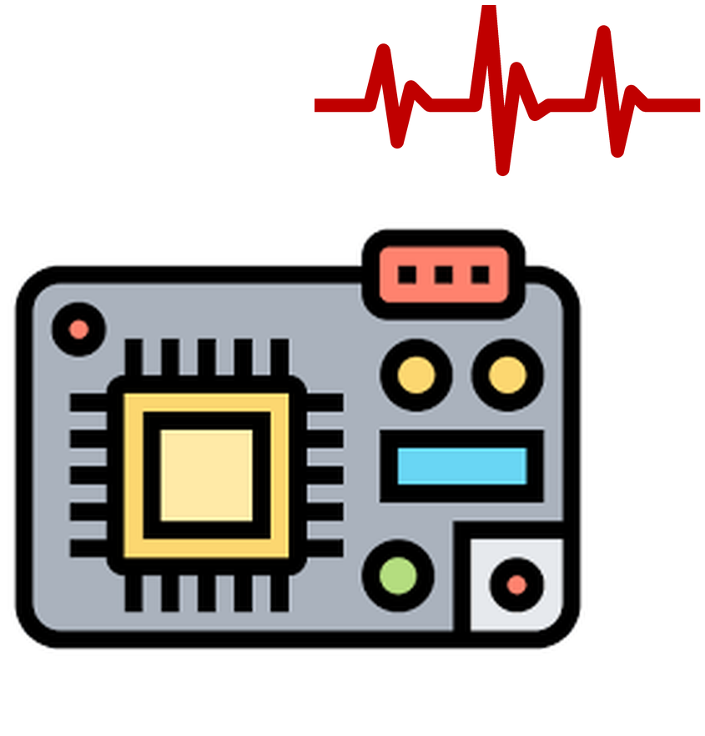



Power Side-Channel Attacks on
Machine-Learning-based Quantum
Error Correction Decoders
Anthony Etim¹ and Jakub Szefer²
1
2
Computer Architecture
and Security Lab (CASLAB)
Notes:
Thank the session chair. I’m Anthony Etim from Yale; this is joint work with Jakub Szefer at Northwestern. Machine-learning decoders are moving into the classical control stack of quantum computers. Our earlier work asked whether an attacker can corrupt such a decoder with fault injection. Today’s question is the complementary one: what can a passive attacker learn just by measuring the decoder’s power and timing?

Slide 2
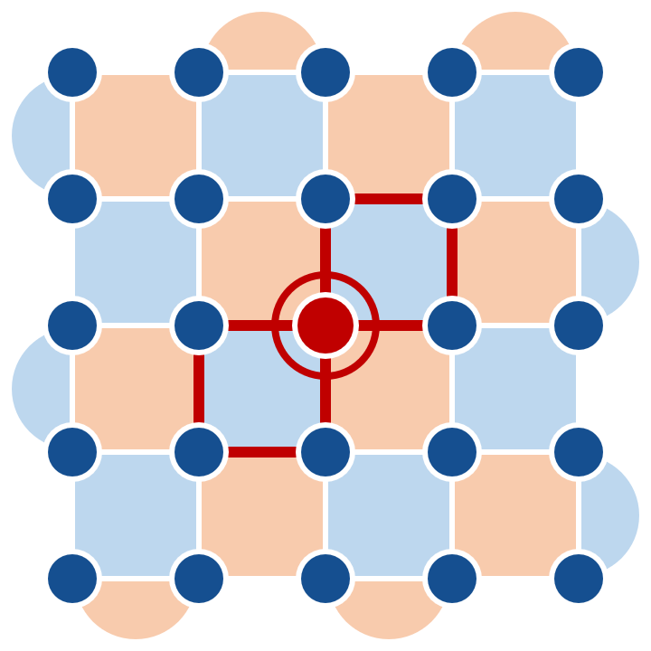

ML Decoders in Quantum Error Correction
QEC spreads one logical qubit over many physical qubits and keeps measuring stabilizer checks.
Distance-5 surface code
25 data qubits (dots) · 24 checks
Each check gives one bit, 1 if an error is nearby. Together, the bits form the syndrome.
1
A classical decoder reads the syndrome and outputs a correction: which data qubit to fix and which Pauli (X or Z).
1
ML decoders learn this mapping and run on the classical controller, inside the trusted computing base.
X error on one data qubit
its two Z checks (blue) read 1
→ Decoder output: X on this qubit
©Anthony Etim
https://anthonyedemetim.com/
2
Notes:
Quick background. Quantum error correction spreads one logical qubit over many physical qubits and keeps measuring stabilizer checks. Each check gives one bit, 1 if an error is nearby, and together these bits form the syndrome. In this distance-5 surface code, an X error on the highlighted data qubit flips the two Z checks beside it. A classical decoder reads the syndrome and outputs the correction: which of the 25 data qubits to fix, and with which Pauli. ML decoders learn this mapping, and they run on the classical controller, inside the quantum computer’s trusted computing base.

Slide 3
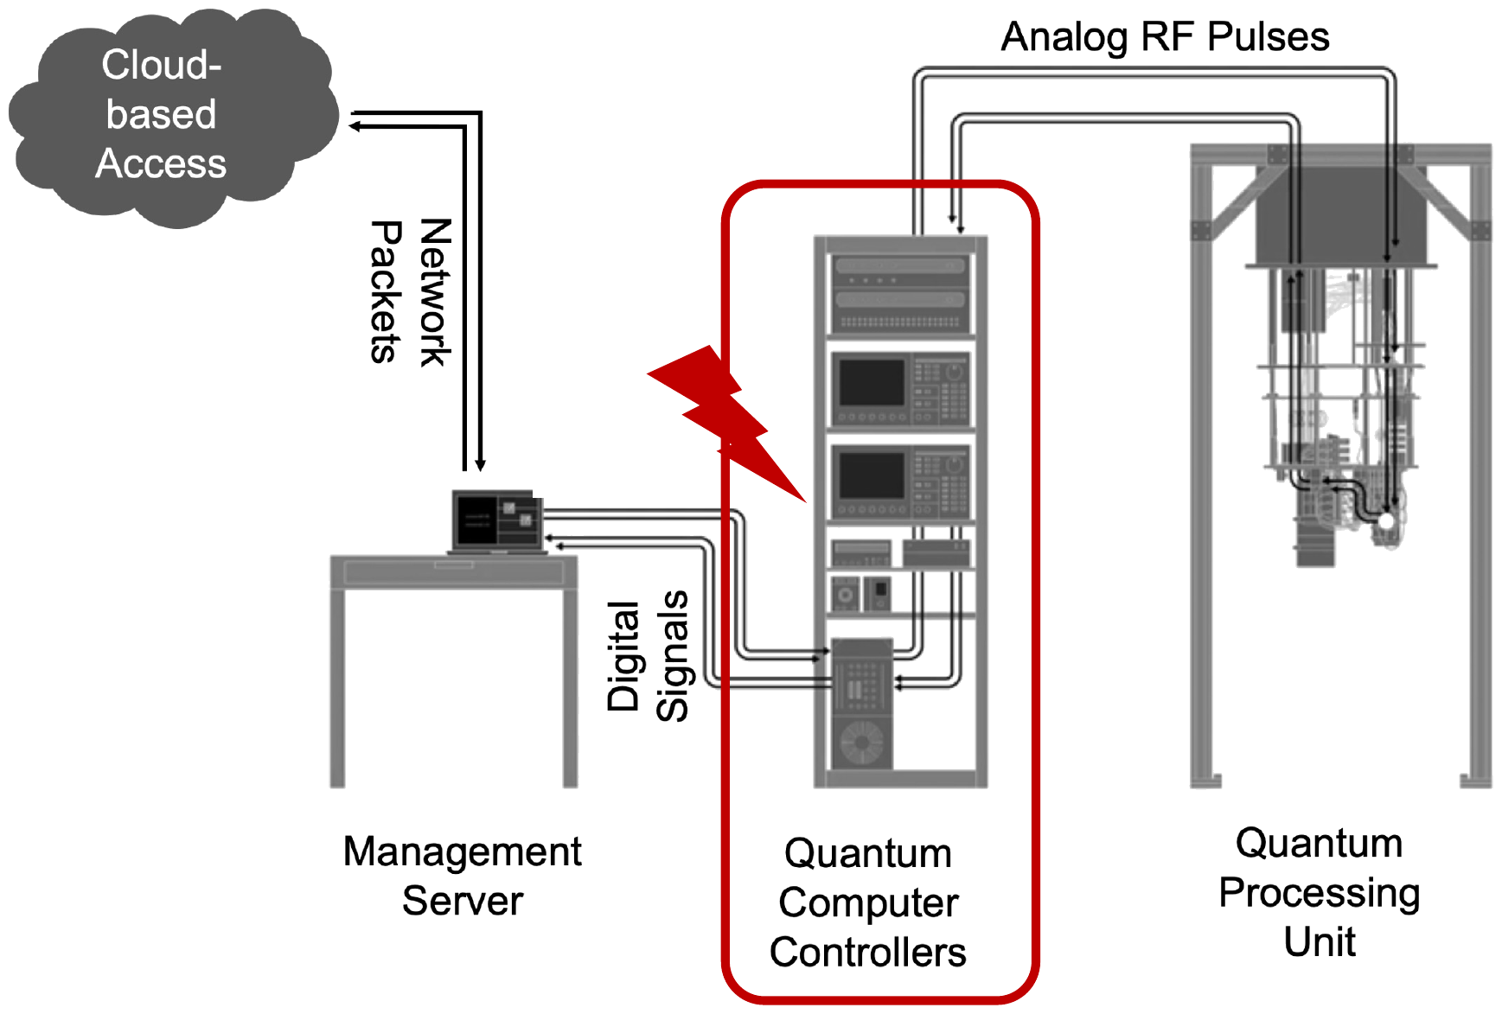
Attack Surface in the Quantum Computer Controller
Prior work: active fault injection
Glitching the decoder can change its corrections. This is an integrity attack.
This work: passive side channels
We only measure the decoder’s power and timing. This is a confidentiality attack.
Even a decoder that always corrects properly can leak which qubit had the error and what type it was.
©Anthony Etim
https://anthonyedemetim.com/
3
Notes:
The decoder runs in the controller electronics, outside the QPU. Prior work, including ours, studied active fault injection, where you glitch the decoder into a wrong correction. That is an integrity attack. Here we ask the confidentiality question instead. Even a decoder that always corrects properly can leak which qubit had the error and what type of error it was, and a passive attacker leaves nothing for the victim to notice.

Slide 4


Threat Model
Adversary Capabilities
Out of Scope
Physical access to the classical controller that runs the decoder.
Glitching the supply or injecting faults.
Modifying the firmware or model weights.
Can measure the power drawn by the decoder’s microcontroller.
Perturbing inference in any way.
Knows the firmware, the set of syndrome inputs and which action fixes which qubit.
EM side channels (not evaluated here).
Training on one device and attacking another (future work).
Profiles on the same device, using labeled power traces.
In practice, this could be an insider, a maintenance technician or a supply-chain actor.
©Anthony Etim
https://anthonyedemetim.com/
4
Notes:
Our attacker is passive. They have physical access to the controller and can measure the power drawn by the decoder’s microcontroller. They know the firmware, the set of syndrome inputs and which action fixes which qubit, and they profile on the same device with labeled traces. They never glitch the supply, change the firmware or weights, or disturb inference in any way. In practice this could be an insider, a maintenance technician or a supply-chain actor.

Slide 5
Adversary’s Goals
What can an attacker with physical access to the controller learn? We evaluate three goals.
1
Qubit-label localization
Which of the 25 data-qubit labels goes with the syndrome the decoder is processing right now?
2
Pauli-type discrimination
For depolarizing noise, is the label of the input syndrome X or Z?
3
Code-size dependent timing
How do execution times change across decoder builds compiled for code sizes d ∈ {5, 7, 9}?
Goals 1 and 2 use the power traces, and goal 3 needs only the timing.
©Anthony Etim
https://anthonyedemetim.com/
5
Notes:
So what does this attacker want to learn? We evaluate three goals. First, qubit-label localization: which of the 25 data-qubit labels goes with the syndrome the decoder is processing right now? Second, Pauli-type discrimination: under depolarizing noise, is that label X or Z? And third, code-size dependent timing: how do execution times change across decoder builds compiled for code sizes 5, 7 and 9? The first two goals use the power traces; the third needs only timing.

Slide 6

Target: Deep Q-Learning Decoder
Sweke et al.’s reinforcement-learning decoder for the d = 5 surface code, trained for bit-flip (X) and depolarizing (DP) noise.
traced on MCU
runs on host
traced on MCU
Syndrome volume
CONV1
Hidden layers
FC3
Dueling head
five 6 × 6 slices of stabilizer bits
first convolution: 64d² outputs, 1,600 at d = 5
the layers between CONV1 and FC3
final dense layer: V(s) and |A| advantages
Q = V + A − mean A; argmax picks the action
Action space at d = 5
Instrumented on the MCU
Deterministic inference
X model: 25 X corrections + 1 terminal action = 26. DP model: 25 X + 25 Z + terminal = 51.
We ported CONV1 and FC3 to C and run each as its own command. The host computes FC3’s input.
Each input always runs the same computation, so captures differ only by noise and environment.
©Anthony Etim
https://anthonyedemetim.com/
6
Notes:
Our target is the deep Q-learning decoder of Sweke et al. for the distance-5 surface code, trained for bit-flip and for depolarizing noise. A convolutional network with a dueling head maps a syndrome volume, five 6-by-6 slices, to Q-values, and the argmax picks the correction. That gives 26 possible actions for the bit-flip model and 51 for the depolarizing model. We ported two layers to C and trace them on the microcontroller: CONV1, the first convolution, and FC3, the final dense layer. The layers in between run on the host, which also supplies FC3’s input.

Slide 7
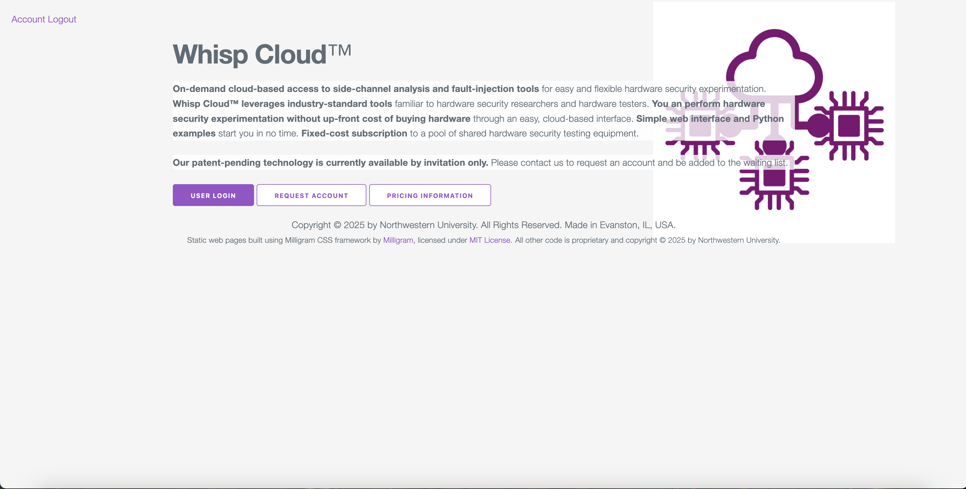
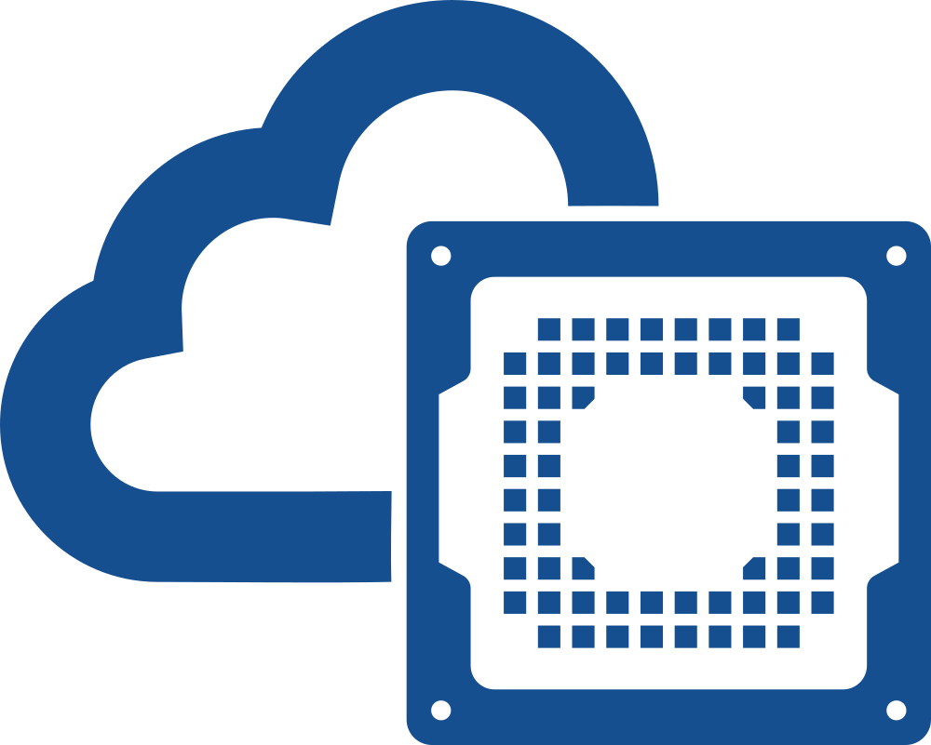
Remote Experiments on Whisp Cloud
Northwestern University’s on-demand, cloud-based access to side-channel analysis and fault-injection tools.
Whisp Cloud
https://whisp.cloud
Every power trace in this work was collected on Whisp Cloud. We thank Whisp Cloud for providing free access.
©Anthony Etim
https://anthonyedemetim.com/
7
Notes:
All of our measurements ran remotely through Whisp Cloud, Northwestern University’s on-demand service for side-channel analysis and fault-injection tools. Through it we used a ChipWhisperer-Husky with a CW312T-SAM4S Cortex-M4 target, and every power trace in this paper was captured this way. Thanks to Whisp Cloud for the free access.

Slide 8
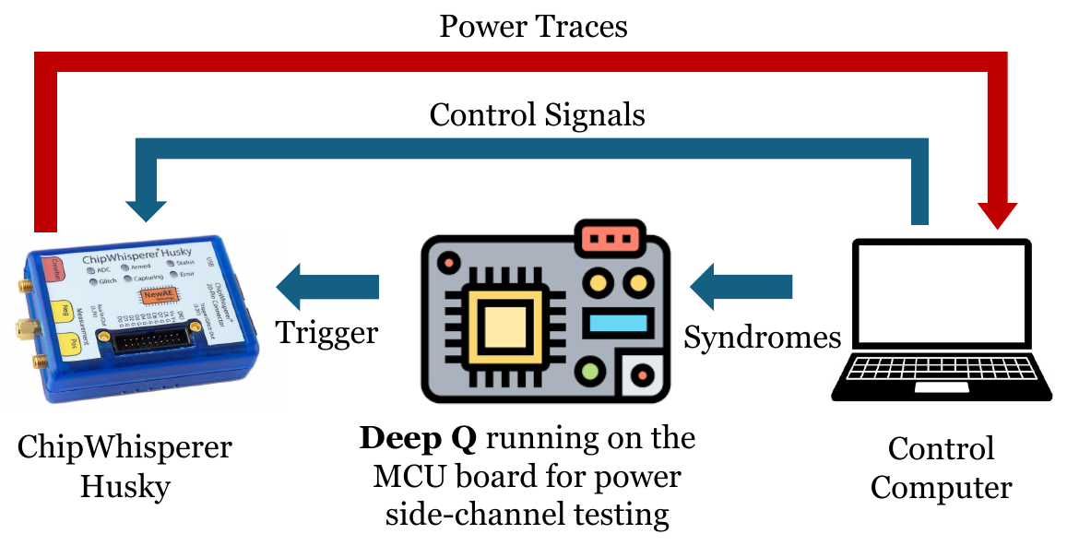



Evaluation Setup
We measure power remotely through Whisp Cloud, and a GPIO trigger marks each unit of computation.
Whisp Cloud: remote access to ChipWhisperer Husky boards
Target: Cortex-M4
(CW312T-SAM4S, ATSAM4S2A)
Sampling: 8 samples per target clock, ≈ 58.9 MHz
trig_count: the Husky counts samples while the trigger is high
For each capture, the host sends a syndrome volume (or FC3’s input), the trigger rises just before one unit of computation, and the Husky records a fixed-length power trace.
©Anthony Etim
https://anthonyedemetim.com/
8
Notes:
Concretely, the target runs at about 7.36 MHz and the Husky takes eight samples per clock, about 58.9 MHz. For each capture, the host sends a syndrome volume, or FC3’s input, and the firmware raises a GPIO trigger right before one unit of computation. The rising edge starts a fixed-length capture: 131,000 samples for CONV1 and 24,000 for FC3. The Husky also counts how long the trigger stays high, and that count is our timing measurement.

Slide 9
Training the Side-Channel Classifier
Every result that follows comes from classifiers we trained on labeled power traces.
our own classifier
Labeled traces
Train/test split
Features
MLP classifier
Prediction
40 labeled captures per input
repeats 0–29 for training, 30–39 for testing
means of 100-sample blocks, giving 1,310 (CONV1) or 240 (FC3)
two ReLU hidden layers, Adam, early stopping
qubit label (25 classes, goal 1) or Pauli X / Z (2 classes, goal 2)
©Anthony Etim
https://anthonyedemetim.com/
9
Notes:
Every result that follows comes from classifiers we trained ourselves. This is a profiled attack: we capture labeled power traces on the same device, 40 captures of each input, and use repeats 0 to 29 for training and 30 to 39 for testing. Each trace is averaged over blocks of 100 samples, giving 1,310 features for CONV1 and 240 for FC3, standardized with training-set statistics only. A small MLP with two ReLU hidden layers, trained with Adam and early stopping, predicts the qubit label or the Pauli type. We feed it the whole window, with no points of interest, and train 15 models per task and window: three capture sessions times five seeds.

Slide 10
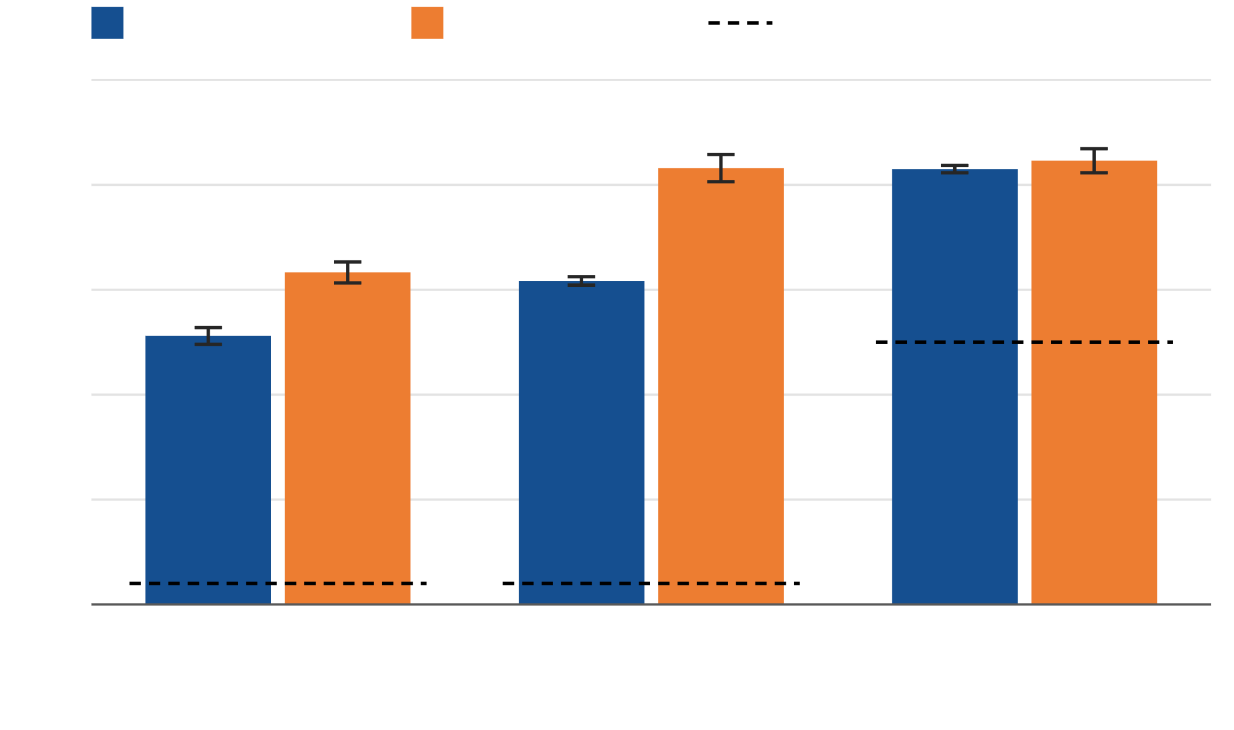
Goals 1 and 2: Power Side-Channel Accuracy
CONV1 window
FC3 window
random guessing
83.2%
100%
83.2%
83.0%
84.6%
for the qubit label from the FC3 window (DP model). Random guessing gets 4%.
80%
63.3%
61.7%
60%
51.2%
40%
20%
84.6%
0%
Qubit label, X model
(25 classes)
Qubit label, DP model
(25 classes)
Pauli X vs Z, DP model
(2 classes)
for Pauli X vs Z from the FC3 window, with CONV1 close behind at 83.0%.
©Anthony Etim
https://anthonyedemetim.com/
10
Notes:
Here are goals 1 and 2. Each bar is the mean over 15 models, three capture sessions times five seeds, and the dashed lines show random guessing. For goal 1, the qubit label, with 25 classes and 4% chance, we reach 51.2% from CONV1 and 63.3% from FC3 on the bit-flip model, and 61.7% and 83.2% on the depolarizing model. So FC3 beats CONV1 by 12.1 and 21.5 points. For goal 2, the Pauli type, where chance is 50%, we reach 83.0% from CONV1 and 84.6% from FC3. One caveat: the attack recognizes new captures of inputs it has profiled; it does not label syndromes it has never seen.

Slide 11
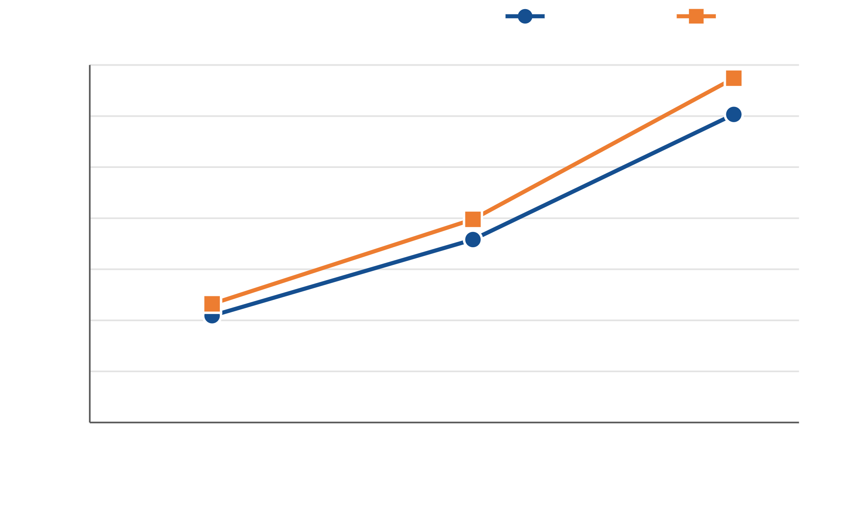
Goal 3: Timing Reveals the Code Size
We built the firmware for d = 5, 7 and 9 (same d = 5 weights, zero-padded inputs) and timed the whole CONV1 layer.
CONV1 duration (million samples)
X model
DP model
70
67.4 M
60
60.3 M
50
39.8 M
40
30
35.8 M
23.2 M
20
20.9 M
10
0
d = 5
d = 7
d = 9
Code distance d the firmware is built for
Anyone who can time CONV1 can tell the code size d, without training a classifier.
©Anthony Etim
https://anthonyedemetim.com/
11
Notes:
Goal 3 needs only timing. CONV1 computes its 64 d-squared output positions one at a time, so we built the firmware for d = 5, 7 and 9, reusing the d = 5 weights with zero-padded inputs, and held the trigger high over the whole layer. For the bit-flip model, the mean duration grows from about 21 to 60 million samples. Neighboring builds differ by at least 24.7 times the larger standard deviation, so the ranges never overlap, and two more sessions reproduced every count exactly. Anyone who can time CONV1 can tell which code size the decoder was built for, without a classifier.

Slide 12
Summary
1
2
Qubit label leaks through power
The error type leaks too
The first power side-channel attack on an ML QEC decoder finds which of the 25 data qubits it corrects, with up to 83.2% accuracy (4% by guessing).
A second classifier tells whether the correction is a Pauli X or Z, with 84.6% accuracy (50% by guessing).
3
4
Timing reveals the code size
The last layer leaks more
How long CONV1 runs shows which code distance the decoder was built for (d = 5, 7 or 9).
For qubit localization, the final dense layer (FC3) beats the first convolution (CONV1) by 12.1 points (bit-flip) and 21.5 points (depolarizing).
Paper: doi.org/10.1145/3857307.3857309
©Anthony Etim
https://anthonyedemetim.com/
12
Notes:
To sum up, one point per goal. Passive power traces from an embedded ML decoder reveal which qubit it corrects, with up to 83.2% accuracy across 25 classes, and the Pauli type, with 84.6%. The duration of CONV1 alone reveals the code size the decoder was built for. And comparing the two windows, the final dense layer leaks more than the first convolution for the qubit label. The main message is that the embedded QEC decoder should be treated as confidentiality-critical, not only integrity-critical.

Slide 13

Power Side-Channel Attacks on Machine-Learning-based
Quantum Error Correction Decoders
Thank you!
anthony.etim@yale.edu
Questions?
Paper: doi.org/10.1145/3857307.3857309
Supported in part by NSF grants 2245344 and 2332406. Data collected via the Whisp Cloud service.
©Anthony Etim
https://anthonyedemetim.com/
13
Notes:
Thank you. Thanks to NSF for support and to Whisp Cloud for free access to its side-channel platform. Happy to take questions.

Slide 14
Trace Capture and Classification
Two capture windows per input; one classifier pipeline for both.
1
2
Capture windows
Classifier
CONV1: 131,000 samples, covering the first of 1,600 output positions plus ~8–9 more.
Average 100-sample blocks → 1,310 (CONV1) or 240 (FC3) features.
FC3: 24,000 samples of the first output neuron, V(s).
MLP, two ReLU hidden layers (100/50 units; 64/32 for X vs Z), Adam, early stopping.
The FC3 window holds a full X neuron in 96.2% of captures, but only 52% of a DP neuron.
Uses the whole window, with no points of interest.
Software floating point: ~905–919 samples per multiply-accumulate.
3 capture sessions × 5 seeds = 15 models per task and window.
©Anthony Etim
https://anthonyedemetim.com/
14
Notes:
Two windows per input. For CONV1 we record 131,000 samples — close to the Husky’s single-capture maximum — starting at the first of 1,600 output positions; that covers the triggered position plus roughly eight to nine more of the same filter. For FC3 we record 24,000 samples starting at the first output neuron, the state value V(s). Because the firmware uses software floating point, each multiply-accumulate costs roughly 905 to 919 samples, so this window holds a complete X neuron in 96.2% of captures but only the first 52% of a DP neuron. We do not normalize leakage per operation; we compare how much information each window yields. The classifier averages blocks of 100 samples, standardizes with training-set statistics only, and feeds the whole window to a small MLP — no points of interest. Each task and window is evaluated in three capture sessions with five seeds each, so every number is a mean over 15 models.

Slide 15
Dataset and Classification Tasks
Task | Inputs | Classes | Train | Test
X qubit localization | 25 | 25 | 750 | 250
DP qubit localization | 50 | 25 | 1,500 | 500
DP Pauli X / Z | 50 | 2 | 1,500 | 500
What one input is
A 5 × 6 × 6 binary syndrome volume: five 6 × 6 slices of stabilizer outcomes.
One distinct input per decoder action: 26 (X model) and 51 (DP model).
Each input is captured 40 times, split by repeat index:
Dropping the terminal IDLE/STOP action (no qubit or Pauli type) leaves balanced classes.
Training: repeats 0–29 (75%)
Test: 30–39
DP: one X input and one Z input for each of the 25 qubits.
Test captures come from the same inputs used in profiling, so the classifier has to recognize new captures of them.
Scope: we recognize new captures of profiled inputs, not arbitrary physical errors, since syndromes are degenerate.
©Anthony Etim
https://anthonyedemetim.com/
15
Notes:
The dataset holds one distinct syndrome volume per decoder action: 26 for the X model and 51 for the depolarizing model. We drop the terminal IDLE/STOP action because it has no qubit coordinate or Pauli type, which leaves 25 and 50 inputs and perfectly balanced classes. Each input is captured 40 times; repeats 0 to 29 train the classifier and 30 to 39 test it. Important caveat: these repeats add no new inputs — each task has only 25 or 50 distinct inputs. Because syndromes are degenerate, a qubit label is not in general recoverable from an arbitrary syndrome, so we ask a narrower question: can the attacker recognize a new capture of an input they profiled?

Slide 16
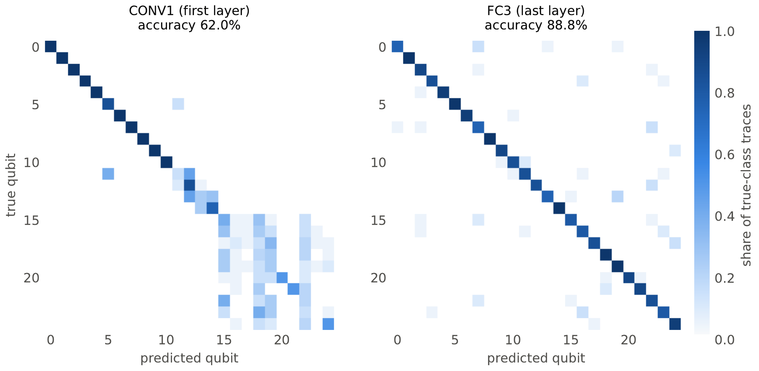
Qubit Localization: Where the Classifier Errs
Depolarizing model, one seed and one capture session (this run: 62.0% and 88.8%; means: 61.7% and 83.2%).
CONV1 (first layer)
Qubits 0–10 are recognized almost perfectly; qubits 15–24 are confused with one another.
FC3 (last layer)
Close to diagonal across all 25 qubits.
Why some qubits separate better is still an open question.
©Anthony Etim
https://anthonyedemetim.com/
16
Notes:
To see where the errors come from, these are confusion matrices from a single depolarizing-model run. With the CONV1 window — 62.0% in this run — qubits 0 through 10 are recognized almost perfectly, and most of the confusion is among qubits 15 to 24. With FC3 — 88.8% in this run — the matrix is close to diagonal. The means over all 15 models are 61.7% and 83.2%. Note that the classifier only chooses among profiled inputs; it cannot yet label syndrome volumes it never saw in training. Why some qubit labels separate better than others is an open question for future work.

Slide 17
Backup: Accuracy and Variability
Task | Window | Accuracy | Session std | Seed std
Qubit localization, X (25 classes) | CONV1 | 51.2% | 1.6 pts | 1.1 pts
 | FC3 | 63.3% | 2.0 pts | 3.2 pts
Qubit localization, DP (25 classes) | CONV1 | 61.7% | 0.8 pts | 0.8 pts
 | FC3 | 83.2% | 2.6 pts | 1.9 pts
Pauli X / Z, DP (2 classes) | CONV1 | 83.0% | 0.7 pts | 1.2 pts
 | FC3 | 84.6% | 2.3 pts | 2.9 pts
Accuracy: mean over 15 models (3 capture sessions × 5 classifier seeds).
Session std: standard deviation of the 3 per-session mean accuracies, with Bessel’s correction (n − 1).
Seed std: within each session, standard deviation over the 5 seeds (n), then averaged over sessions.
©Anthony Etim
https://anthonyedemetim.com/
17
Notes:
Backup: the full aggregates from Table 3 of the paper, with both variability measures, for questions about how stable the results are across capture sessions and classifier seeds.

Slide 18
Backup: CONV1 vs. FC3 Capture Windows
 | CONV1 window | FC3 window
Trigger covers | First of 1,600 output positions (64d², d = 5) | First output neuron, V(s): a dot product of length |A|
Trigger high, X / DP | 15,012 / 16,308 samples | 23,882 / 46,175 samples
Recorded window | 131,000 samples (8.7× / 8.0× the trigger) | 24,000 samples
Window contents | Triggered position + ~8–9 more of the same filter | Whole X neuron in 96.2% of captures; first 52% of a DP neuron
Features after 100-sample means | 1,310 | 240
FC3 trigger ratio DP / X = 1.93 ≈ action-count ratio 51/26 = 1.96 → ~905–919 samples (≈ 113–115 cycles) per multiply-accumulate.
The whole CONV1 layer lasts 20.9 million samples (X, d = 5); an average position takes 13,067 samples because zero inputs are skipped.
We compare the information each window yields, not the leakage per operation or per complete layer.
©Anthony Etim
https://anthonyedemetim.com/
18
Notes:
Backup: details of the two capture windows, for questions about why the FC3 and CONV1 numbers should not be read as per-operation or per-layer leakage. The CONV1 window is about 8 to 9 times longer than its triggered position; the FC3 window is close to one neuron’s length, so it covers a full X neuron but only half of a DP neuron.

Slide 19
Key Observations
FC3 leaks more for localization
Error type leaks from both layers
FC3 beats CONV1 by 12.1 points (X) and 21.5 points (DP), possibly because FC3 produces the operands the correction scores are built from.
Pauli X vs Z reaches 83.0% from CONV1 and 84.6% from FC3, a 1.6 point gap within the measured variability.
Timing reveals the configuration
Correct outputs are not enough
CONV1’s duration grows with its 64d² output positions, so the code size d can be read without a classifier.
Checks for wrong outputs, resets, non-finite values or disagreement between redundant runs do not stop passive measurement.
Power and timing reveal what the decoder decided and how it is built, so treat it as confidentiality-critical.
©Anthony Etim
https://anthonyedemetim.com/
19
Notes:
Stepping back, four observations. First, which layer you measure matters: for localization FC3 is substantially better, plausibly because FC3 produces the operands from which the correction scores are formed while CONV1 transforms the raw syndrome tensor. But our two windows also differ in length, instrumentation point and signal-to-noise ratio, so the data do not isolate that explanation. Second, the error type leaks from both layers; the 1.6-point gap is within the measured variability. Third, timing alone exposes configuration. Fourth, and most important for defenders: the usual answers to fault injection — checking for wrong outputs, resets, non-finite values, or disagreement between redundant inferences — do nothing against passive measurement.

Slide 20
Limitations & Future Directions
Profiled inputs only
The attack recognizes new captures of inputs seen in profiling; labeling unseen syndrome volumes is open, and degenerate syndromes rule out unique error reconstruction.
One device, sessions close in time
All training and testing use one Cortex-M4 target; transfer across boards, probes, gains, time gaps and environments is untested.
Layer comparison is not controlled
CONV1 and FC3 windows differ in length, instrumentation point, signal-to-noise ratio and exposed work; a follow-up should equalize time and multiply-accumulate counts.
Other implementations and countermeasures
Fully embedded decoders, parallel FPGA/RFSoC designs, EM side channels and constant-work countermeasures remain to be evaluated.
©Anthony Etim
https://anthonyedemetim.com/
20
Notes:
Some limitations. The attack recognizes new captures of inputs the attacker profiled; it does not yet generalize to syndrome volumes never seen in training, and because syndromes are degenerate it cannot reconstruct a unique physical error. Everything ran on one Cortex-M4 board, with sessions recorded close together, so portability across devices, probes, gains and time is untested. The CONV1-versus-FC3 comparison is not a controlled experiment; a follow-up should compare equal-time observations, equal multiply-accumulate counts, several CONV1 positions, and whole-layer captures. And we have not evaluated fully embedded decoders that run all layers back to back, FPGA or RFSoC implementations, EM channels, or constant-work countermeasures.

Slide 21
Physical Side Channels in the Quantum Stack
CMOS power draw depends on data and operations, so it reveals values software never outputs.
Side channels in the quantum stack
Work | Observed signal | Inferred information
Erata et al.; Xu et al. | Controller power | Control pulses and quantum circuits
TraceQ | Surface-code patch activity | Fault-tolerant circuit dataflow
Shukla et al. | Syndrome stream | Logical-gate fingerprints
This work | ML decoder power | Qubit error location and error type
Profiled attacks: train on labeled traces from a controlled setting, then classify new ones.
Embedded neural networks are natural targets, because inference is regular and data-dependent.
Here the secret is the label the decoder assigns to a syndrome, not a model weight.
Our work is the first to attack the ML decoder itself.
©Anthony Etim
https://anthonyedemetim.com/
21
Notes:
Physical side channels exploit the fact that CMOS power draw depends on the data being processed. In a profiled attack, the adversary first collects labeled traces on a device they control, trains a model, and then classifies new observations. Neural networks on embedded devices leak well because their inference schedule is regular and data-dependent. In the quantum stack, prior side-channel work recovered control pulses and circuits from controller power, reconstructed fault-tolerant dataflow from surface-code patch activity (TraceQ), and found logical-gate fingerprints in the syndrome stream. Nobody had looked at the power of the ML decoder itself. That is our target, and the secret we go after is the label the decoder attaches to a syndrome.

