Slide 1





Voltage Fault Injection Against
On-Device Language Models
Anthony Etim¹ and Jakub Szefer²
1
2
Computer Architecture
and Security Lab (CASLAB)
Notes:
Thank the session chair. I’m Anthony Etim from Yale; this is joint work with Jakub Szefer at Northwestern. Small transformer language models now run directly on microcontrollers. This talk asks what happens when an attacker with physical access glitches the supply voltage while such a model is generating text: where in the forward pass the glitches land, what they do to the output, and whether a simple recomputation check catches them.

Slide 2

On-Device Language Models
Small transformer LMs now run on edge boards, and tiny ones fit on microcontrollers.
One token step, six stages
embed token and position lookup
Text is generated one token at a time, with one forward pass per token.
qkv query, key, value projections
kv_write append to the KV cache
Each step writes state, such as the KV cache, that later steps read.
softmax causal attention
mlp feed-forward block
An attacker with physical access can also glitch the power supply while the model generates text.
lm_head vocabulary logits
Every later token reads the KV cache.
©Anthony Etim
https://anthonyedemetim.com/
2
Notes:
Language models are now small enough for edge boards, and tiny ones fit on microcontrollers. Generation is a long computation, one forward pass per token, and each step writes state that later steps read. The key-value cache is the obvious example. We split each token step into the six stages on the right and glitch each one separately. And an attacker who physically holds the device can do more than pick the input. They can glitch the supply while it generates text.

Slide 3


Threat Model
Adversary Capabilities
Out of Scope
Has physical access to a device that runs an LM locally.
Modifying the firmware.
Reading or replacing the model weights.
Can glitch the supply during text generation.
Confidentiality attacks and model extraction.
Reruns inference on chosen inputs while tuning the glitch.
Invasive probing.
Sees whether the device responds, raises an alarm, or emits a different token.
Timing glitches in the field (we use a firmware trigger).
The attacker wants a wrong token with no alarm.
©Anthony Etim
https://anthonyedemetim.com/
3
Notes:
The attacker physically holds the device, can glitch its supply during generation, reruns chosen inputs while tuning the glitch, and sees whether it responds, raises an alarm or emits a different token. The goal is a wrong token with no alarm. One caveat: we time glitches from a firmware trigger that marks each stage, so our rates measure susceptibility under exact timing, not the success rate of a field attack.

Slide 4
Target: A Tiny Transformer with a KV Cache
Karpathy’s microgpt, rewritten in C with the weights compiled in
microgpt target
Execution windows (target clock cycles)
whole
1,629,016
Architecture
1 layer · 4 heads · KV cache
mlp
781,152
Sizes
qkv
346,996
embedding 16 · MLP 64 · context 16
Vocabulary
lm_head
196,372
27 characters (trained on names)
softmax
81,572
Parameters
4,192 learned (no biases)
embed
16,640
Stage triggers
kv_write
996
one marked region per experiment
The six stage windows cover 1,423,728 of 1,629,016 cycles; normalization, residual additions and attention scores take the rest.
©Anthony Etim
https://anthonyedemetim.com/
4
Notes:
Here is the model we attack. It follows Karpathy’s microgpt: one layer, four heads, a KV cache and a 27-character vocabulary trained on names, 4,192 parameters in all. It is a toy, but it has every part of a decoder-only transformer that matters here. The firmware holds a trigger high during the whole pass or during one of the six stages. The windows range from 781 thousand cycles for the MLP to under a thousand for the cache write.

Slide 5
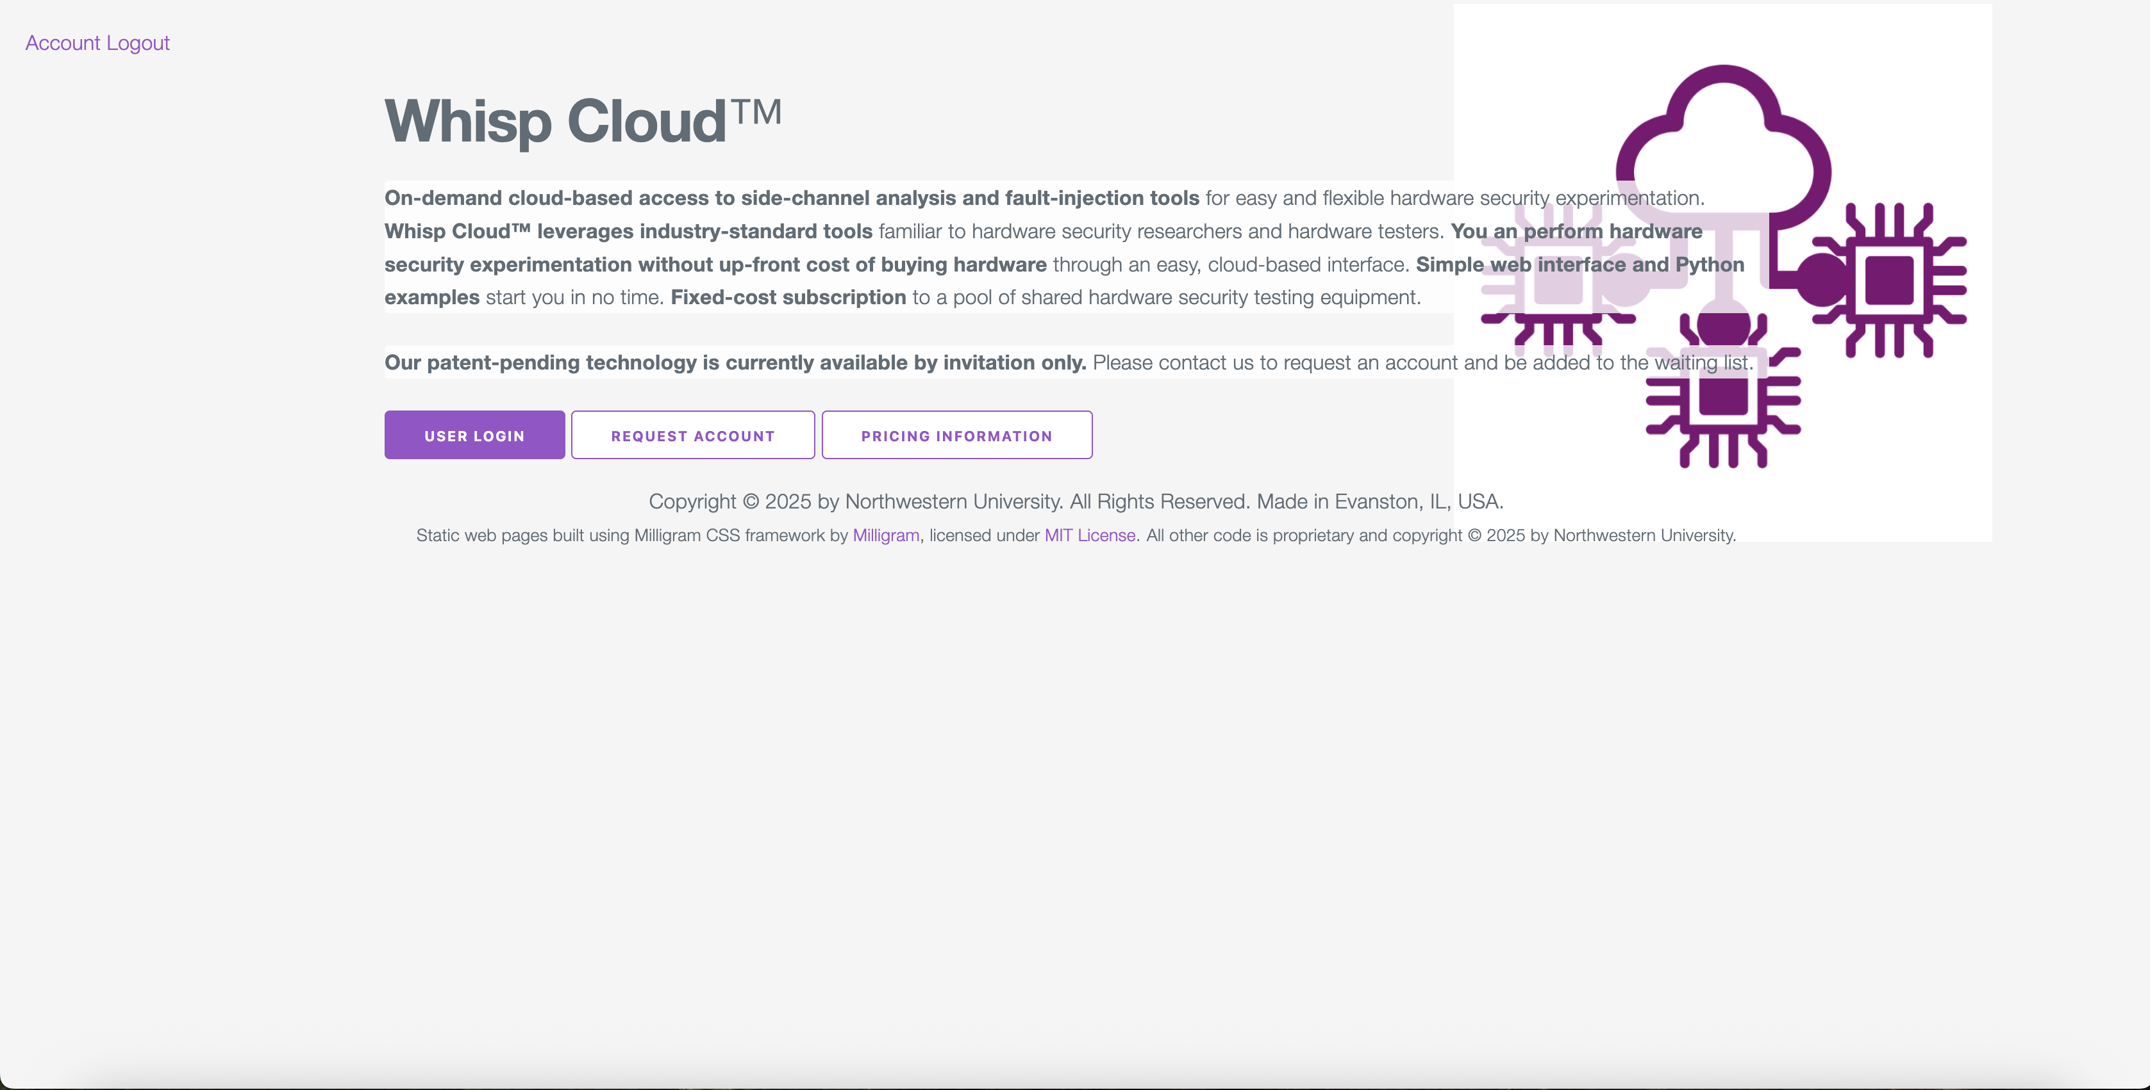

Remote Experiments on Whisp Cloud
Northwestern University’s on-demand, cloud-based access to side-channel analysis and fault-injection tools.
Whisp Cloud
https://whisp.cloud
Every glitch experiment in this work ran on Whisp Cloud. We thank Whisp Cloud for providing free access.
©Anthony Etim
https://anthonyedemetim.com/
5
Notes:
We ran every glitch experiment remotely through Whisp Cloud, Northwestern University’s on-demand service for side-channel and fault-injection tools. Thanks to Whisp Cloud for the free access.

Slide 6
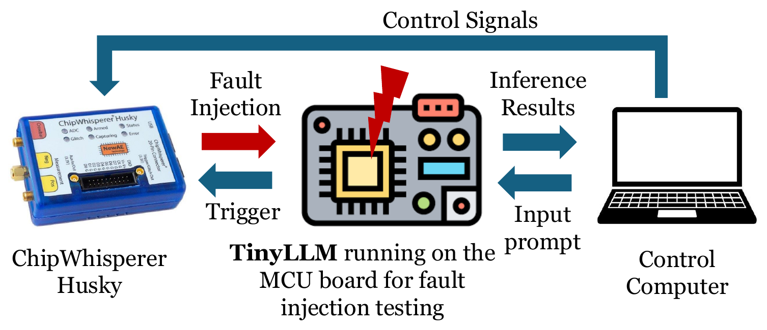



Hardware Setup
A ChipWhisperer-Husky clocks the target and fires the crowbar glitch, timed from the firmware’s stage trigger.
Whisp Cloud: remote access to the Husky and target
Target: SAM4S Cortex-M4 at 7.3636 MHz, clocked by the Husky
Crowbar: a MOSFET briefly shorts the supply rail to ground
ext_single: fires once, a set number of cycles (the offset) after the trigger
©Anthony Etim
https://anthonyedemetim.com/
6
Notes:
The Husky clocks the target at 7.3636 MHz and fires a crowbar glitch: a MOSFET briefly shorts the supply rail to ground, once, a chosen number of cycles after the stage trigger. We call that delay the offset, and it decides which part of the computation the glitch hits. A 3,000-attempt Optuna search picked one glitch setting, a pulse of about 62 nanoseconds, which we keep throughout. We see the glitch’s effect only at the outputs.

Slide 7

Baseline Defense: Recomputation Check
The firmware runs each token step twice and compares the outputs, a standard check that we use as a baseline.
glitched
not glitched in our tests
Save state
Pass 1
Restore
Pass 2
Compare
copy the state before the step
the forward pass we glitch
reload the saved state
run the step again, without a glitch
all 27 logits; any difference above 10⁻⁵ raises an alarm
Compares every logit
Overhead
Detection only
It can raise an alarm even when the emitted token (the arg max) is unchanged.
About 1.63 million extra cycles per token (221 ms), roughly twice the compute.
After the check we keep Pass 1’s state, so generation continues with the fault and we can track it.
We assume the second pass, the comparison and the restore are never glitched, although a real attacker could target them.
©Anthony Etim
https://anthonyedemetim.com/
7
Notes:
The defense we test is a simple recomputation check. Before each token, the firmware saves the state and runs the forward pass; this is the pass we glitch. It then restores the saved state, runs the step again without a glitch, and compares all 27 logits. If any of them differs by more than 10 to the minus 5, it raises an alarm. This roughly doubles the compute per token. We never glitch the second pass or the comparison, although a real attacker could.

Slide 8
Research Questions
With the model, the glitch and the check set up, we ask four questions.
RQ1
Can a glitch make the model go wrong without crashing (an anomaly), and how often does it crash?
RQ2
Does it matter which stage we glitch, or which prompt the model gets?
RQ3
Do the check’s alarms match real changes in the output token?
RQ4
Can one glitch change a later token, not just the current one?
The attacker wins only with a wrong token and no alarm, which we call a silent token change.
©Anthony Etim
https://anthonyedemetim.com/
8
Notes:
With the model, the glitch and the check set up, we ask four questions. One: can a glitch make the model go wrong without crashing the board, and how often does it crash? We call going wrong without a crash an anomaly. Two: does it matter which stage we glitch, or which prompt the model gets? Three: do the check’s alarms match real changes in the output token? And four: can one glitch change a later token, not just the current one? The attacker wins only with a wrong token and no alarm, which we call a silent token change.

Slide 9
RQ1 and RQ2: Every Stage Has a Vulnerable Offset
For each stage, we searched for a glitch timing (offset) that works well, then tried it 300 times.
non-crash anomaly (all alarms)
crash
no effect
100%
mlp@531,080
99.7%
of these anomalies set off the check’s alarm
qkv@76,296
80.3%
16.7%
0–45%
lm_head@134,397
77.3%
of attempts crash, depending on the stage: none for mlp, 45% for kv_write
embed@8,549
74.7%
softmax@32,967
63.7%
27.0%
0.9–5.4%
of attempts cause an anomaly if you glitch at a random time in the stage
kv_write@724
43.0%
45.0% crash
So the attack depends mostly on glitching at the right moment.
©Anthony Etim
https://anthonyedemetim.com/
9
Notes:
RQ1 and RQ2 first. For each stage, we searched for a glitch timing that works well, then tried it 300 times. Every stage has such a timing: 43% to 99.7% of attempts cause an anomaly without crashing, and 100% of those anomalies set off the check’s alarm. The crash rate depends on the stage: none for the MLP, 45% for the cache write. But if you glitch at a random time in the stage, only 0.9 to 5.4% of attempts cause an anomaly. So the attack depends mostly on glitching at the right moment.

Slide 10
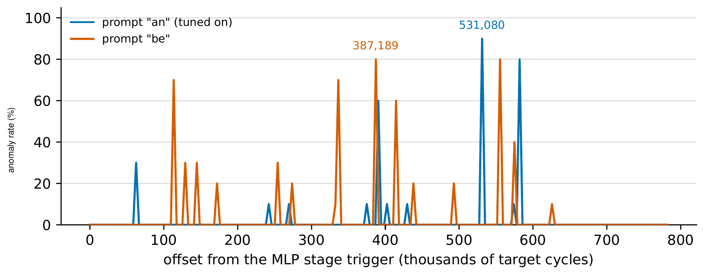
RQ2: Vulnerable Offsets Move With the Input
Anomaly rate at each MLP timing we tried, for the prompts “an” and “be” (10 tries per timing).
0 / 100
anomalies on “be” at mlp@531,080 (299 / 300 on “an”)
73–79%
anomaly rate at embed@8,549 on all four prompts (the only tested timing that transferred)
On “be”, the tuned spike is gone, but new spikes appear elsewhere in the MLP.
Protecting only the cycles found on one prompt is not enough.
©Anthony Etim
https://anthonyedemetim.com/
10
Notes:
Still RQ2: the good timing also moves with the input. This plot scans the MLP stage under two prompts, and each spike is a timing that works. The timing we tuned on “an”, 531,080, causes an anomaly 299 times in 300 on “an”, but 0 times in 100 on “be”. On “be”, new spikes appear instead, such as 8 of 10 at 387,189, and 15 timings work against 10 on “an”. Only the embed timing held up, at 73 to 79% on all four prompts. So protecting only the cycles found on one input leaves the stage exposed.

Slide 11
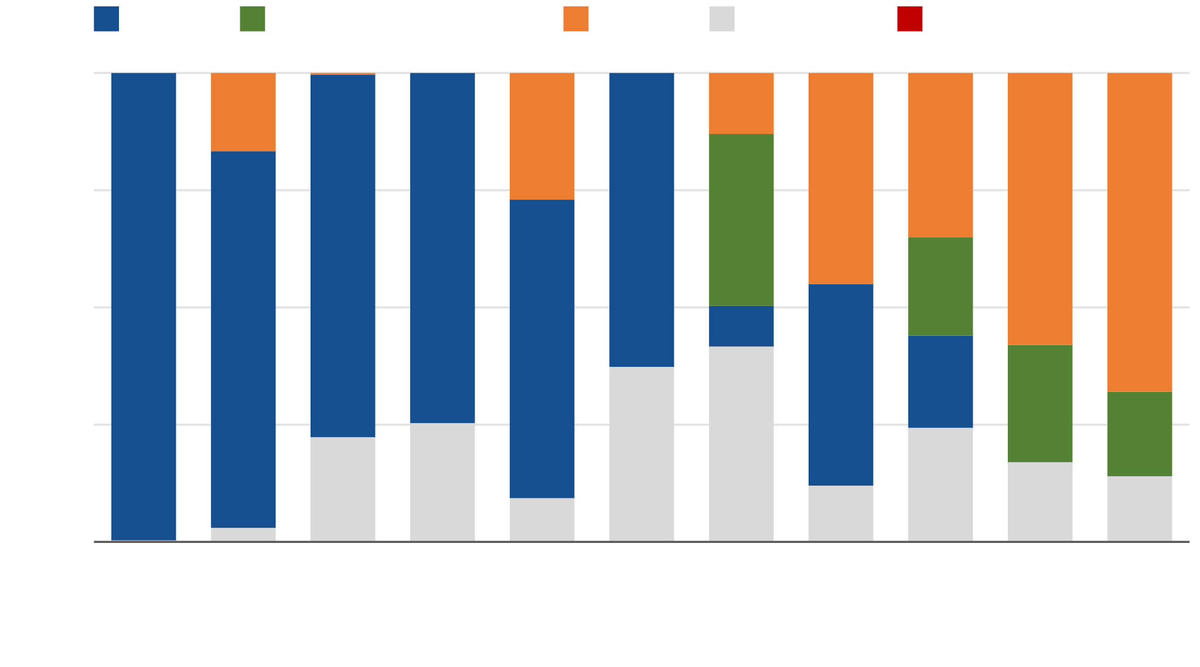
RQ3: Do the Alarms Match Real Token Changes?
What happened at 11 glitch timings, with 300 attempts each.
alarm
wrong logits at host
crash
no effect
silent token: none
100%
0 / 6,100
75%
wrong tokens without an alarm (at most 0.049% per attempt, 95% confidence)
50%
299 / 300
alarms at mlp@531,080, with the correct token every time
25%
0%
mlp
531k
qkv
76k
lm_head
134k
embed
8.5k
softmax
33k
whole
700k
lm_head
22.6k
kv_write
724
whole
379k
lm_head
13.7k
lm_head
4.9k
Stopping the device on every alarm would turn these glitches into denial of service.
©Anthony Etim
https://anthonyedemetim.com/
11
Notes:
RQ3: do the alarms match real token changes? Not exactly. Across 6,100 attempts, the model never output a wrong token without an alarm, so the rate is at most 0.049% per attempt, and that is with an unglitched second pass. But alarms far outnumber real changes. At the MLP timing, 299 of 300 attempts raised an alarm, yet the token was right every time, because the check compares all 27 logits and tiny changes set it off. So if the device stops on every alarm, these glitches become denial of service. The green bars show wrong logits reaching the host with no alarm.

Slide 12
RQ4: One Glitch Can Change a Later Token
We glitch one token step at one of seven timings, then let the model write up to 12 more tokens without glitches.
No glitch
a
end
Glitch at qkv@76,296 · 4 runs never stop
4.9%
a
a
a
a
a
a
a
a
a
a
a
a
12-token limit
of qkv@76,296 runs have a correct glitched token and a wrong next token
Glitch at lm_head@22,563 · 10 runs change the first letter
m
a
end
same as with no glitch
changed or extra token
The normal output is one letter, so this shows what can happen, not how often.
So the glitch broke something the next step reads, like the KV cache.
©Anthony Etim
https://anthonyedemetim.com/
12
Notes:
RQ4: can one glitch change a later token? We glitch one step and let the model keep writing up to twelve more tokens with no more glitches. With no glitch, it writes “a” and stops. At qkv@76,296, the glitched step still wrote the right “a”, but in 4.9% of runs the model then never stopped and ran to the twelve-token limit. So the glitch broke something the next step reads, like the KV cache. At lm_head@22,563 the glitched token itself changed, which is the ordinary case. We did not take memory snapshots, so we cannot prove it was the KV cache.

Slide 13
Summary
1
2
Every stage can be faulted
Timing depends on the input
We glitched all six stages of a 4,192-parameter transformer on a Cortex-M4. Each stage has an offset where 43.0–99.7% of attempts cause an anomaly.
An MLP offset that faulted on 299 of 300 attempts under one prompt produced no anomalies under another.
3
4
More alarms than token changes
One glitch can change a later token
In 6,100 attempts, no wrong token got past the check. At the MLP offset it also raised 299 alarms in 300 attempts, with the correct token every time.
A glitch can leave the current token correct and change a later one, which fits corrupted state carried between tokens.
Paper: doi.org/10.1145/3857307.3857310
©Anthony Etim
https://anthonyedemetim.com/
13
Notes:
To summarize, one answer per question. Every stage of a small transformer’s forward pass has offsets where a voltage glitch causes non-crash anomalies, at a crash cost that depends on timing. The vulnerable offsets move with the input. The recomputation check caught every token change we observed but raised far more alarms than there were token changes. And one glitch can change a later token. So defenses for on-device language models should protect the computation in every stage and the state carried between tokens, not only the stored weights.

Slide 14
Voltage Fault Injection Against
On-Device Language Models
Thank you!
anthony.etim@yale.edu
Questions?
Paper: doi.org/10.1145/3857307.3857310
Supported in part by NSF grants 2245344 and 2332406. Experiments run via the Whisp Cloud service.
©Anthony Etim
https://anthonyedemetim.com/
14
Notes:
Thank you. Thanks to NSF for support and to Whisp Cloud for free access to the fault-injection setup. Happy to take questions.

Slide 15
Search, Re-tests and Outcome Categories
Glitch setting fixed after the search (width 2,100, phase offset 2,600, repeat 2); rates come from offsets the scan selected.
1
2
Finding offsets
Outcome categories, in order
Setting: 3,000-attempt Optuna (TPE) search over width, phase offset and repeat.
Crash: the target stops responding.
Alarm: the check sets fault_flag.
Crashes earn zero reward in the search.
Silent token: token changed, no alarm.
Scan each stage window: 10 attempts per sampled offset.
Read-back mismatch: same token, wrong logits.
Re-test every offset that faulted with 300 new attempts.
NAR = (alarms + silent + mismatches) / N
©Anthony Etim
https://anthonyedemetim.com/
15
Notes:
We chose the glitch setting with a 3,000-attempt Optuna search using the tree-structured Parzen estimator, sampling width from 2,000 to 2,290, phase offset from 1,800 to 4,000 and repeat of 1 or 2, with zero reward for crashes; it selected width 2,100, phase offset 2,600 and repeat 2. Then, per stage, we scan the window with ten attempts per sampled offset — enough to see whether an offset faults, not how often — and re-test each offset that faulted with 300 new attempts. Because the scan chose these offsets, their rates describe the most vulnerable offsets we found, not a typical offset in the stage. Each attempt gets one category, checked in order: crash; alarm if fault_flag is set; silent token if the emitted token changed without an alarm; read-back mismatch if there was no alarm and the token is unchanged but the logits the host reads back are wrong; otherwise no effect. The first three together are the non-crash anomalies, and their rate is NAR.

Slide 16
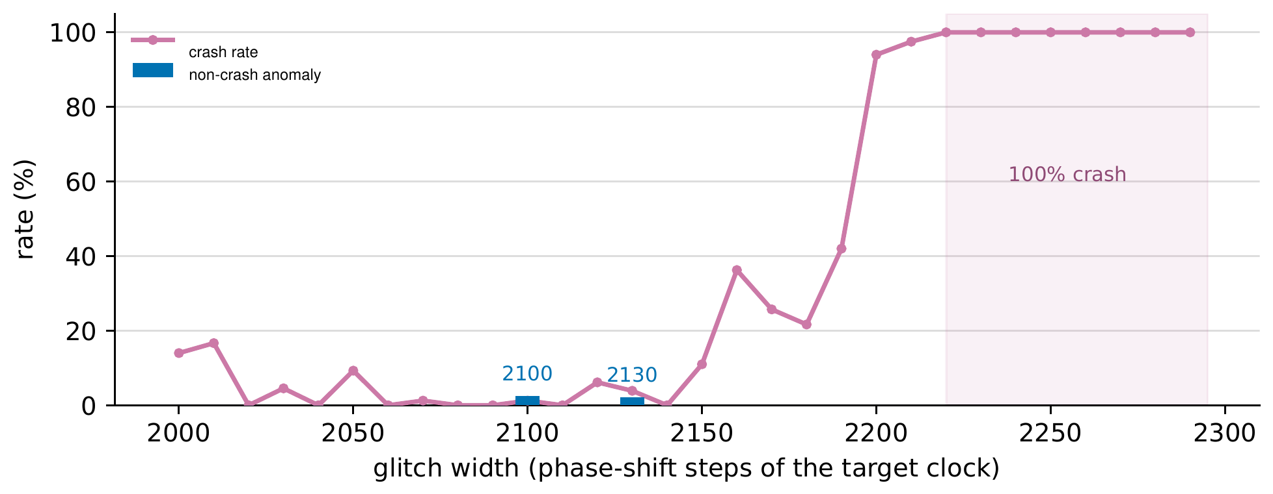
RQ1: Faults Without Crashes, and Their Cost
Parameter search (3,000 attempts): phase offset and repeat varied with width, so this is not a controlled width sweep.
2.5% · 2.2%
non-crash anomalies at widths 2100 and 2130 (none at 2110 or 2120)
94% → 100%
crash rate at width 2200, and from 2220 upward
43 of 52
whole-pass scan anomalies fall between 400k and 800k cycles
Timing sets the crash cost
Late cycles are not safe
whole@379,324: 122 anomalies and 105 crashes in 300; four selected stage offsets crash at most once in 300.
Stage scans find vulnerable MLP and lm_head offsets past the 800k point of the whole pass.
©Anthony Etim
https://anthonyedemetim.com/
16
Notes:
RQ1: can glitches cause anomalies without crashing the device, and at what crash cost? The parameter search sampled thirty widths from 2,000 to 2,290 while varying phase offset and repeat, so this plot shows which settings worked and where crashes dominate, not a controlled width sweep. Non-crash anomalies appear at widths 2,100 and 2,130, with grouped rates of 2.5 and 2.2%, but not at 2,110 or 2,120. Crash rates stay between 0 and 17% below 2,150, reach 94% at 2,200 and 100% from 2,220 up. Crash cost depends strongly on timing: at whole@379,324 the chosen setting produces 122 anomalies and 105 crashes in 300 attempts, while four of the selected stage offsets crash at most once in 300. A coarse whole-pass scan with an 8,145-cycle stride finds 52 anomalies, 43 of them between 400 and 800 thousand cycles — but later cycles are not safe: the stage scans find vulnerable offsets in the MLP and LM-head stages, which run past that point.

Slide 17
Backup: Outcome Counts and Wilson Intervals
Location | D | A | R | S | C | NE | NAR [Wilson 95%]
mlp@531,080 | 299 | 299 | 0 | 0 | 0 | 1 | 0.997 [0.981, 0.999]
qkv@76,296 | 241 | 241 | 0 | 0 | 50 | 9 | 0.803 [0.755, 0.844]
lm_head@134,397 | 232 | 232 | 0 | 0 | 1 | 67 | 0.773 [0.723, 0.817]
embed@8,549 | 224 | 224 | 0 | 0 | 0 | 76 | 0.747 [0.695, 0.793]
softmax@32,967 | 191 | 191 | 0 | 0 | 81 | 28 | 0.637 [0.581, 0.689]
kv_write@724 | 129 | 129 | 0 | 0 | 135 | 36 | 0.430 [0.375, 0.487]
whole@700,470 | 188 | 188 | 0 | 0 | 0 | 112 | 0.627 [0.571, 0.679]
lm_head@22,563 | 136 | 26 | 110 | 0 | 39 | 125 | 0.453 [0.398, 0.510]
whole@379,324 | 122 | 59 | 63 | 0 | 105 | 73 | 0.407 [0.353, 0.463]
lm_head@13,734 | 75 | 0 | 75 | 0 | 174 | 51 | 0.250 [0.204, 0.302]
lm_head@4,905 | 54 | 0 | 54 | 0 | 204 | 42 | 0.180 [0.141, 0.227]
D anomalies, A alarms, R read-back mismatches, S silent tokens, C crashes, NE no effect; every row has D = A + R + S and D + C + NE = 300. White rows: one offset per stage; gray: alarm-evasion candidates and whole-pass controls. Intervals ignore offset selection and board-to-board variation.
©Anthony Etim
https://anthonyedemetim.com/
17
Notes:
Backup: the integer counts behind every rate, from Tables 4 and 5 of the paper, with Wilson 95% intervals for the non-crash anomaly rate. With N = 300 each three-decimal rate corresponds to exactly one count; 0.997 is 299 of 300. The intervals describe repeated trials at a fixed offset and do not account for the offset having been chosen by search, for correlation between attempts, or for variation between boards and sessions.

Slide 18
Backup: Attempts per Experiment
Experiment | Attempts | Used for
Glitch parameter search | 3,000 | Choosing width, phase offset and repeat
Re-tests at eleven offsets | 3,300 | Outcome rates at the selected offsets
Fixed-offset input variation | 2,800 | Whether an offset transfers across prompts
Defense evaluation (two rows above) | 6,100 | Silent-token rate of the check
Host/device diagnostics | 100 | Emitted token versus host arg max
Later-token rollouts | 46–133 per offset | Drift after a single glitch
Rule of three (zero silent tokens): 95% upper bound 3/N = 0.049% (6,100), 0.091% (3,300), 0.107% (2,800) per attempt.
Alarms / (alarms + silent tokens) is not recall: alarms include faults that left the token unchanged.
Recall needs the alarms that also changed the token, which we have for only some offsets.
Diagnostic at lm_head@4,905: the target survived 24 of 60 attempts; the host arg max differed 13 times, the device token never.
©Anthony Etim
https://anthonyedemetim.com/
18
Notes:
Backup: how the attempts are counted. The defense evaluation combines the 3,300 re-tests with the 2,800 fixed-offset attempts, 6,100 in total, none of which was a silent token change; the parameter search, diagnostics, second-prompt scan and rollouts answer other questions and are counted separately. The rule-of-three bounds assume independent attempts with a common rate, which is generous because the offsets were chosen by search, and none of them bounds the probability that the check misses a fault that does change the token. On the read-back mismatches: in a direct diagnostic at lm_head@4,905 the host’s arg max of the read-back logits differed from the reference 13 times while the device’s emitted token never did; two immediate reads returned identical bytes, so a one-off transfer error is unlikely, but buffer selection, restore order, serialization, memory aliasing or the two arg max implementations could each explain it.

Slide 19
Key Observations
Every stage is vulnerable
Timing profiles don’t transfer
Each of six stages has an offset where 43.0–99.7% of glitches cause a non-crash anomaly, so protecting stored weights alone is not enough.
Only the embed offset carried across prompts; the MLP and lm_head peaks moved with the input.
More alarms than token changes
A glitch can affect later tokens
The full-logit check also flags faults that leave the token unchanged, so halting on every alarm would cause denial of service.
One glitch at qkv changed a later token while the current one stayed correct (PDR 0.049).
Defenses need to protect the computation in every stage and the state carried between tokens, not only the stored weights.
©Anthony Etim
https://anthonyedemetim.com/
19
Notes:
Four observations. First, every stage of the forward pass has offsets where most glitches cause anomalies, so a defense that only protects the stored weights — the bit-flip threat model — misses most of what a glitch can do. Second, timing profiles do not transfer: only the embed offset carried across prompts, so hardening the cycles found vulnerable for one input would leave the stage exposed for others; a defense has to protect the computation whatever the cycle. Third, the check compares the whole logit vector while greedy decoding uses only the largest logit, so many alarms come from faults that do not change the token. Halting on every mismatch turns those into denial of service, retrying is unsafe if one disturbance can affect both executions, and voting adds latency and energy; comparing only the final token reduces false alarms but misses faults that corrupt state. Fourth, a glitch can outlive its own token step.

Slide 20
Limitations & Future Directions
Exact timing, not a field attack
Glitches are timed from a firmware trigger on a Husky-clocked target; knowing only when a stage starts, an attacker would see roughly the window average (0.9–5.4%, with 10–12.5% crashes).
One board, one setting, few prompts
One SAM4S board and one glitch setting; two prompts for the MLP scans and four for fixed offsets; the check path was never attacked, and no false-alarm rate was measured without glitches.
A toy model, no instruction trace
4,192 parameters and greedy decoding: rates and stage ordering will not carry over, and we cannot name the corrupted instruction or isolate the KV cache.
Next steps
Time glitches without a firmware trigger, attack the check path itself, move to larger transformers and more boards, and design defenses for inter-token state.
©Anthony Etim
https://anthonyedemetim.com/
20
Notes:
Some limitations. Our timing is exact: the firmware trigger tells the glitcher when a stage starts and the Husky also clocks the target, so every glitch is aligned to a processor cycle. A field attacker would need an external reference — the serial command that starts inference, or a feature of the power trace — and a device with its own oscillator adds drift. We did not measure that jitter, but our data bracket it: 43.0 to 99.7% with exact timing at a selected offset, and roughly the window average, 0.9 to 5.4% with 10 to 12.5% crashes, for an attacker who knows only when a stage starts. All data come from one board, one glitch setting and a few prompts; we never attacked the check path or measured its false-alarm rate without glitches. The model is far smaller than the language models deployed on phones and edge boards, so our numbers should not be carried over — but the questions transfer: does each stage have vulnerable offsets, do they move with the input, and can one glitch corrupt state that later tokens read? The method transfers too: separate the timing search from rate estimation, and report alarms, token changes, crashes and later drift as separate quantities.

Slide 21
Bit Flips vs. Voltage Glitches
Most NN fault studies attack classifiers by flipping a chosen bit of a chosen weight.
Two fault models
 | Bit flips (Rowhammer) | Voltage glitch
Access | Code on the same machine | Physical access to the device
Target | A chosen bit of a stored weight | Whatever executes at the glitch time
Lasts | Until the weight is reloaded | Only for the pulse
Can corrupt | Stored parameters | Activations and cache entries too
Recent work applies this bit-flip model to LLMs: GenBFA, SBFA, BitHydra.
A voltage glitch does not target a bit; the attacker picks a pulse shape and a time.
Physical faults have hit embedded NNs and TinyML, but not an autoregressive transformer.
We fix one mechanism and sweep its timing across the whole forward pass.
©Anthony Etim
https://anthonyedemetim.com/
21
Notes:
Most fault studies of neural networks target classifiers and model the fault as a flip of a chosen bit in a chosen parameter, and recent work applies this model to large language models — GenBFA, SBFA and BitHydra. That model follows Rowhammer: it needs only code on the same machine, and a flipped weight stays wrong until it is reloaded. A voltage glitch is different. It needs physical access and lasts only for the pulse, but it does not select a bit: the attacker picks a pulse shape and a time after a trigger, and whatever instructions and data are in flight get corrupted — including activations and cache entries. Physical fault injection has been shown against embedded neural networks and TinyML classifiers, including our HOST work, but not against the stages of an autoregressive transformer or the state it carries between tokens. So instead of choosing a target and corrupting it, we fix one physical mechanism and sweep its timing across the whole forward pass.

